Slide 1
An introduction to data analysis with code
Single cell RNA analysis from raw counts to basic regression
Jonathan Golob, MD PhD
joanthan@goloblab.org
https://goloblab.org
https://github.com/jgolob/

Slide 2
Disclosures
My wife works for Loxo Oncology, a division of Eli Lilly.
There is no overlap between her work and this presentation.

Slide 3
Itinerary
0. Downloading publicly available data and assembly into an anndata object stored in h5ad format. (I swear I will explain what those things mean.)
Quality control and identification of cell types through a standard approach of slicing, filtering, clustering, and differential gene expression by clusters.
Basic regression and association modeling using the qc’ed, filtered data informed by the cell types identified.

Slide 4
Learning Objectives
- Become familiar with accessing data via code
- Become familiar with 'big data' stored in the anndata format.
- Become familiar with filtering data via slicing of matrices.
- Get hands-on experience with the nuances of processing single cell data, including aspects that have subjective components.

Slide 5
Step 0: Download the public data
Goal here is to make a 'blank canvas' h5ad object to build out...
… and then later check to see if we agree with the "official" analysis.

Slide 6
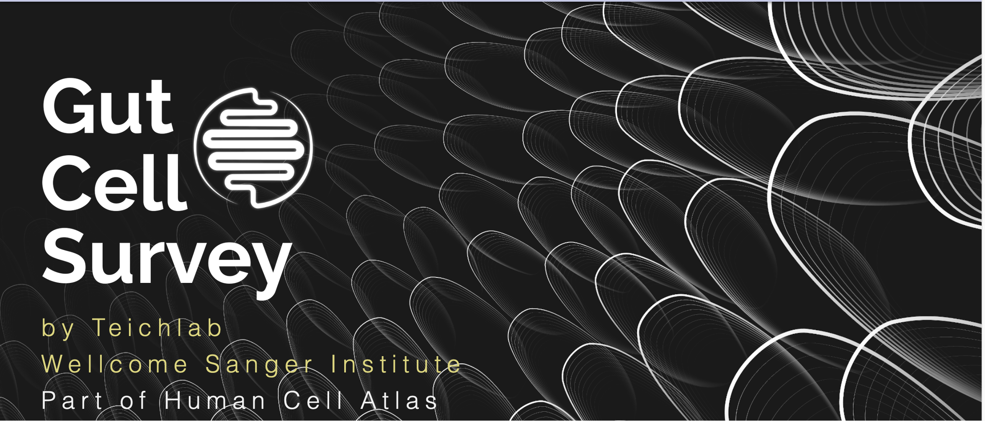

Slide 7
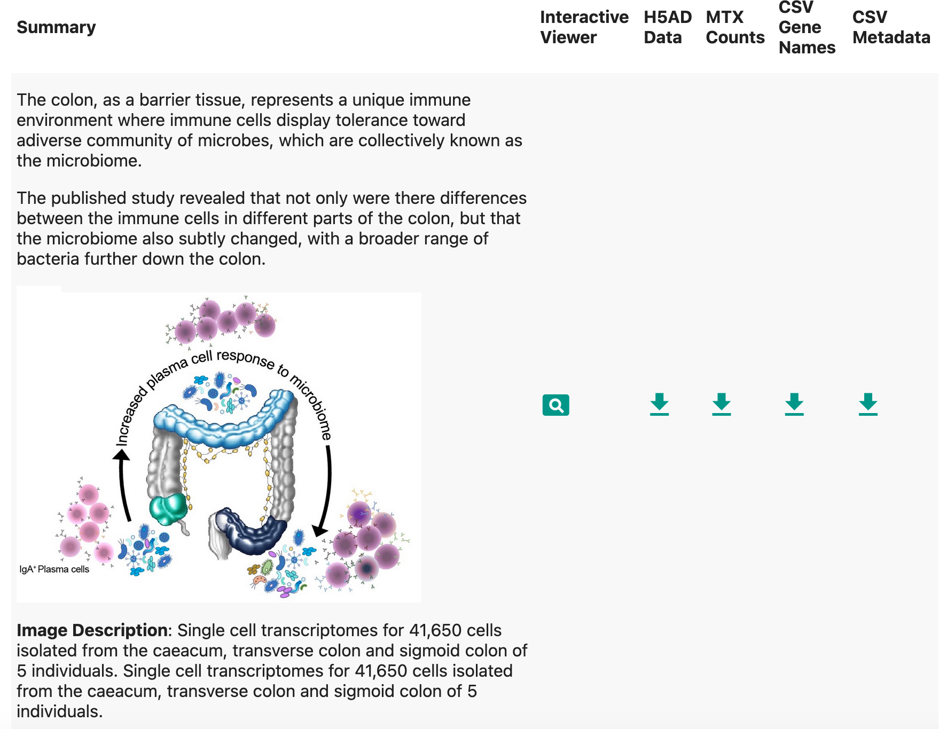
https://www.gutcellatlas.org/#datasets

Slide 8
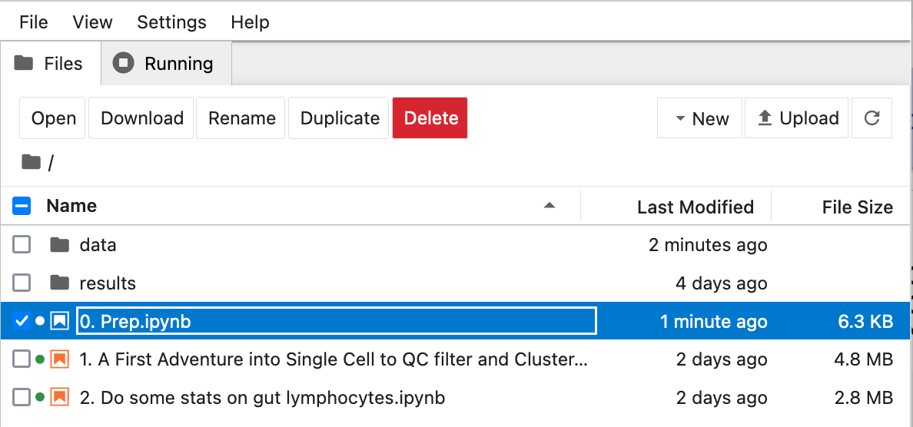
You can follow along interactively via running the jupyter notebooks for each step of our itinerary. The first one will download the data and make the object.
To do so all you need to is to install a relatively recent version of python 3 on your computer, with pip.
Windows PC: You’ll need to install python.
MacOS: Comes with a workable version of python3 already.
Linux: Most come with a workable version of python3

Slide 9
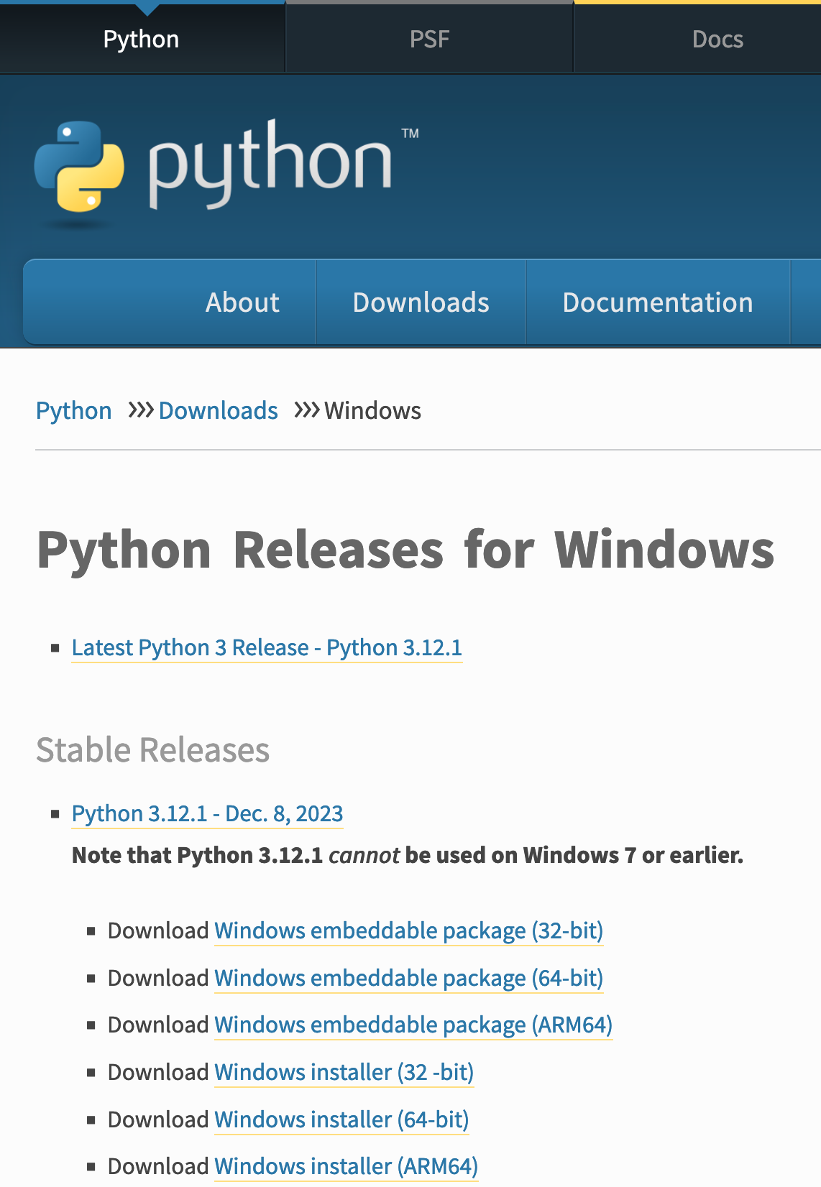
For our Windows Friends:
https://www.python.org/downloads/windows/
Most likely you’ll need this one

Slide 10
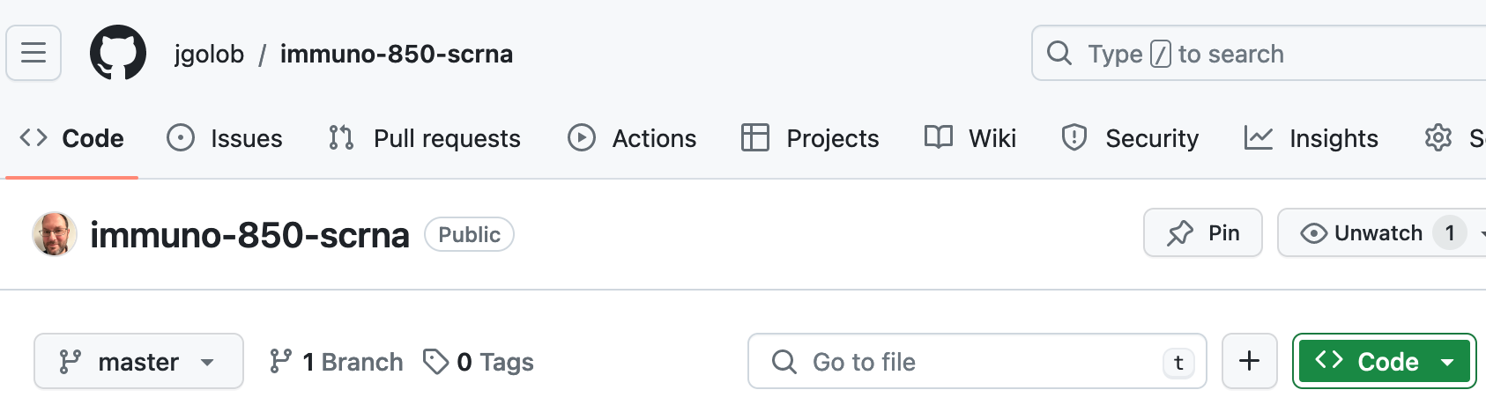
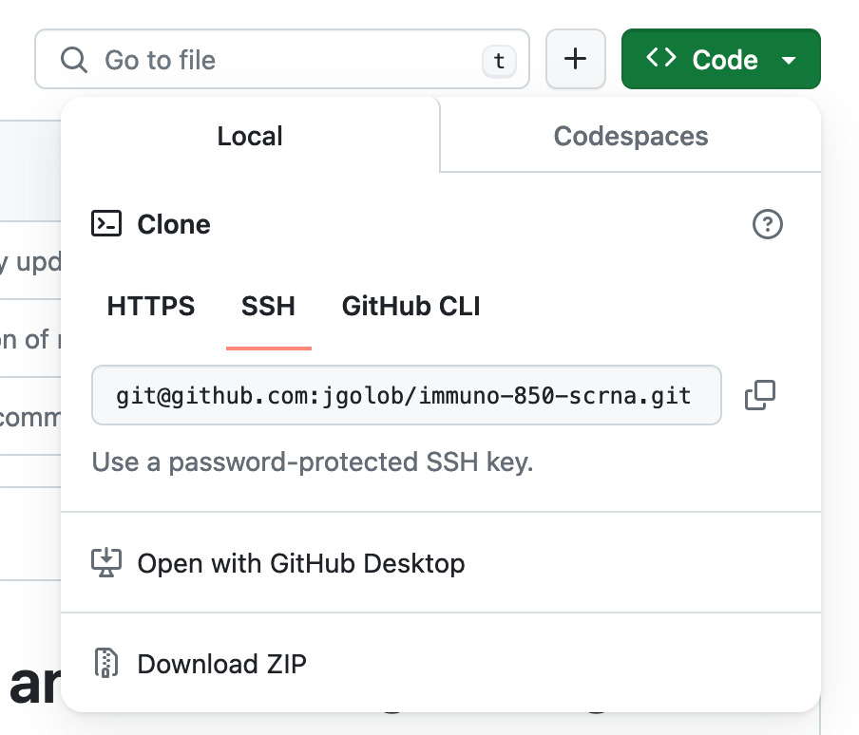
For everyone wanting to follow-along interactively
https://github.com/jgolob/immuno-850-scrna/
Click here
Then here
… and extract the download

Slide 11
For everyone wanting to follow-along interactively
One-time things
1. Open a Command Terminal.
MacOS: “Terminal.app” in “Applications/Utilities”
Windows: ‘cmd.exe’
Linux: ”Terminal” or “xterm” or “kitty” (or you probably know already given you are running linux).
2. Change to the directory where the unzipped file you just downloaded was placed. If you haven’t changed anything it is likely `Downloads/immuno-850-scrna’.
e.g,
`cd Downloads/ immuno-850-scrna`
3. Create a python virtual environment:
`python3 -m venv scrnaenv`
4. Activate the environment:
`source scrnaenv/bin/activate`
5. Install all the needed libraries
`pip3 install -r requirements.txt`

Slide 12
For everyone wanting to follow-along interactively
Every time
1. Open a Command Terminal.
MacOS: “Terminal.app” in “Applications/Utilities”
Windows: ‘cmd.exe’
Linux: ”Terminal” or “xterm” or “kitty” (or you probably know already given you are running linux).
2. Change to the directory where the unzipped file you just downloaded was placed. If you haven’t changed anything it is likely `Downloads/immuno-850-scrna’.
e.g,
`cd Downloads/ immuno-850-scrna`
3. Activate the environment:
`source scrnaenv/bin/activate`
4. Go to the jupyter directory and activate the jupyter notebook.
`cd jupyter`
`jupyter notebook`

Slide 13
One-time things
Use the 0. Prep notebook to download the files and assemble them

Slide 14
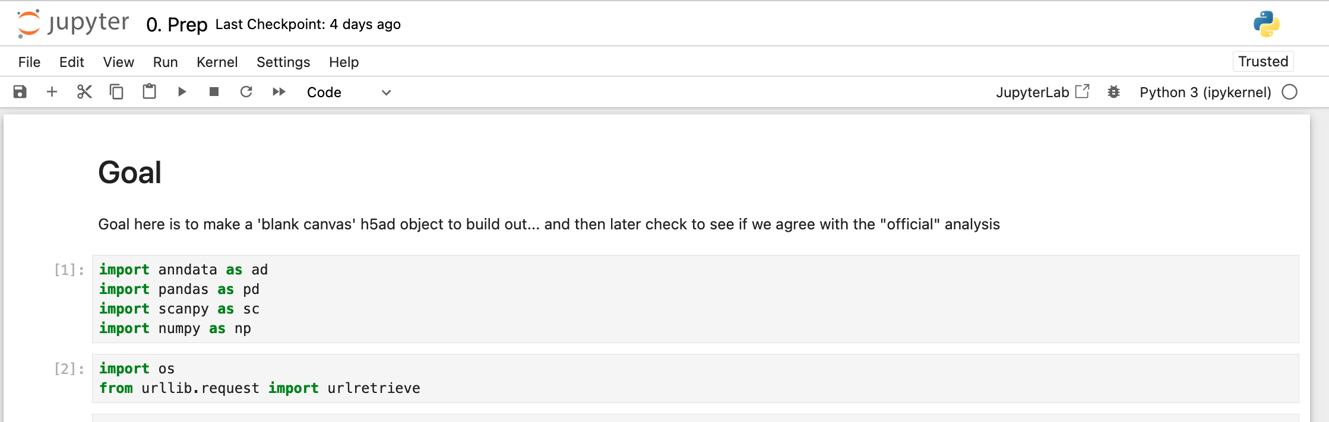
Click here to run a block of code
A block of code

Slide 15
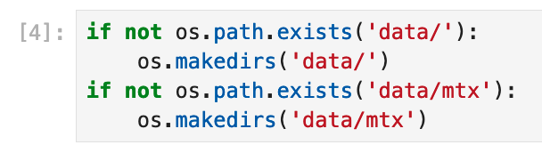
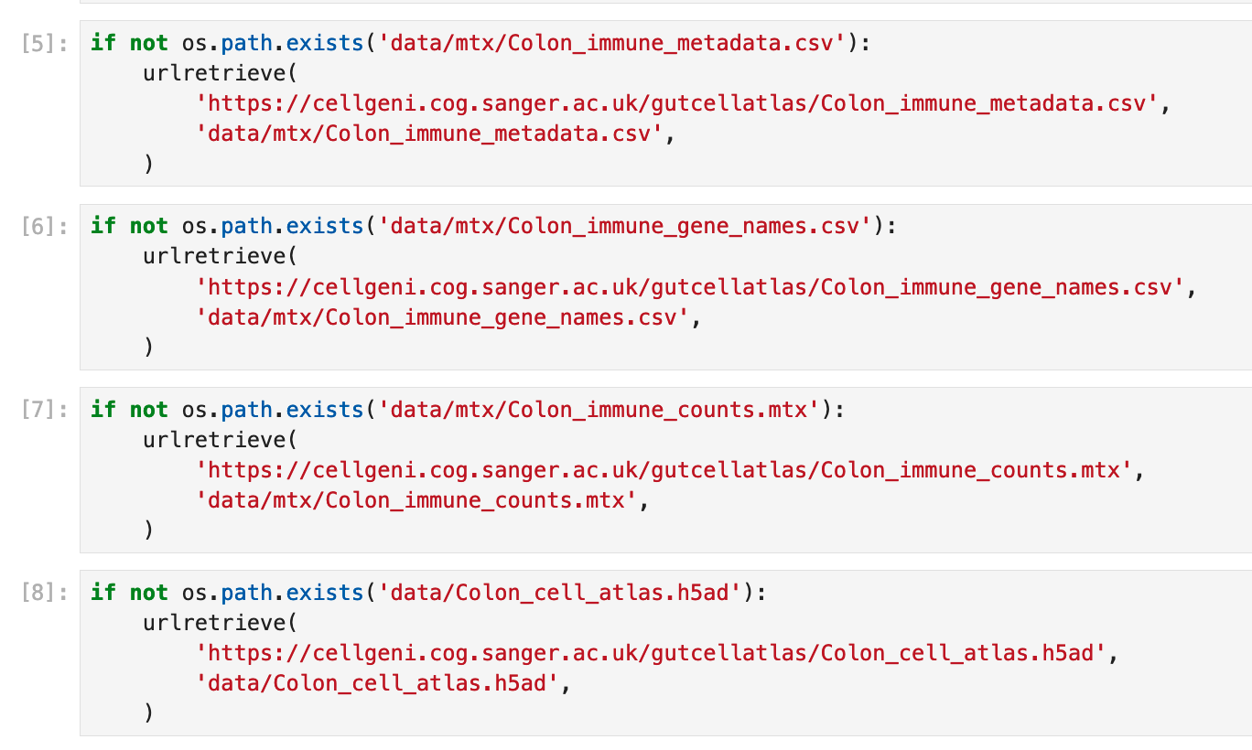
Make places to store the data only if they do not exist
Download the data from the internet, but only if you do not already have a copy (`if not os.pathexists`)

Slide 16
The information from this study we need to do the analysis:
The list of genes that were identified.
Per-cell information (donor, body site, prior fractionation, etc.).
The number of reads that were assigned to a given gene for each cell. (Read-counts; the actual RNA sequencing data).

Slide 17
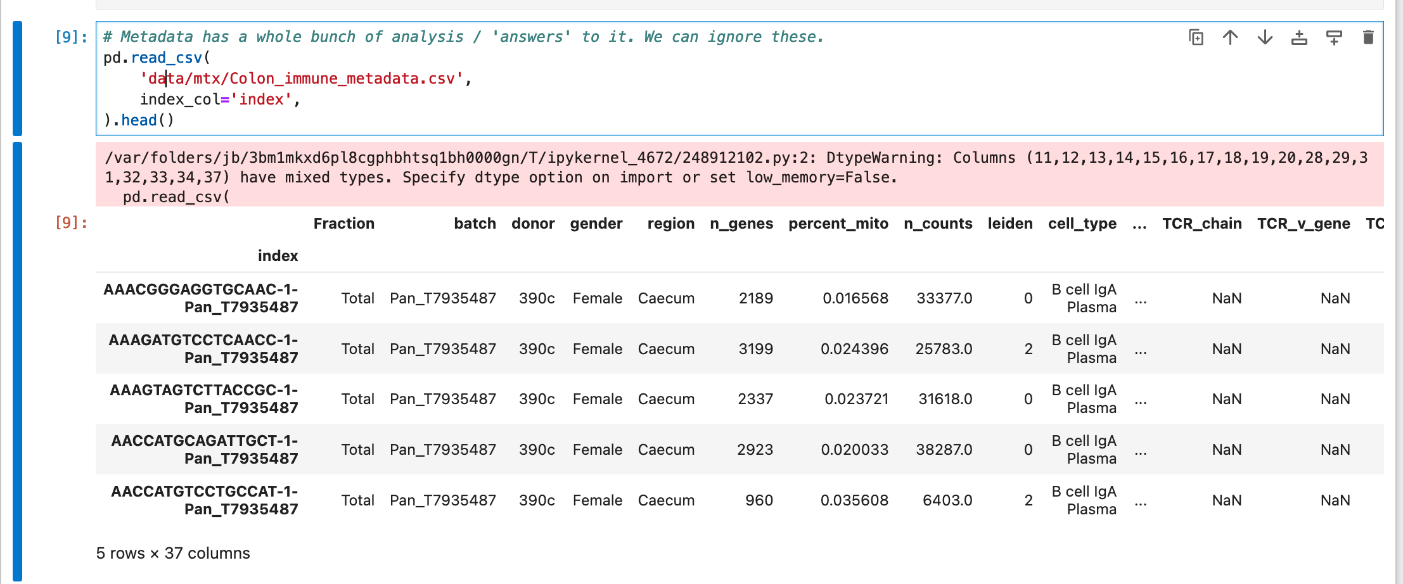
Read in the ‘metadata’ or per-cell information
Code
Output from that code
The metadata is stored in a file that one could conceivably open in Excel, but it is very large (tens of thousands of rows and 37 columns), and may result in Excel struggling to open and work with it.
Excel is also notorious for ‘correcting’ scientific names to things like dates (e.g., the ‘OCT4’ gene to October 4th).

Slide 18
Keeping track of three separate files, keeping them together, in order, and collected is not easy!
Trying to put them all into one Excel workbook will make subsequent things (average by each row, etc) more difficult if we mix metadata with data.

Slide 19
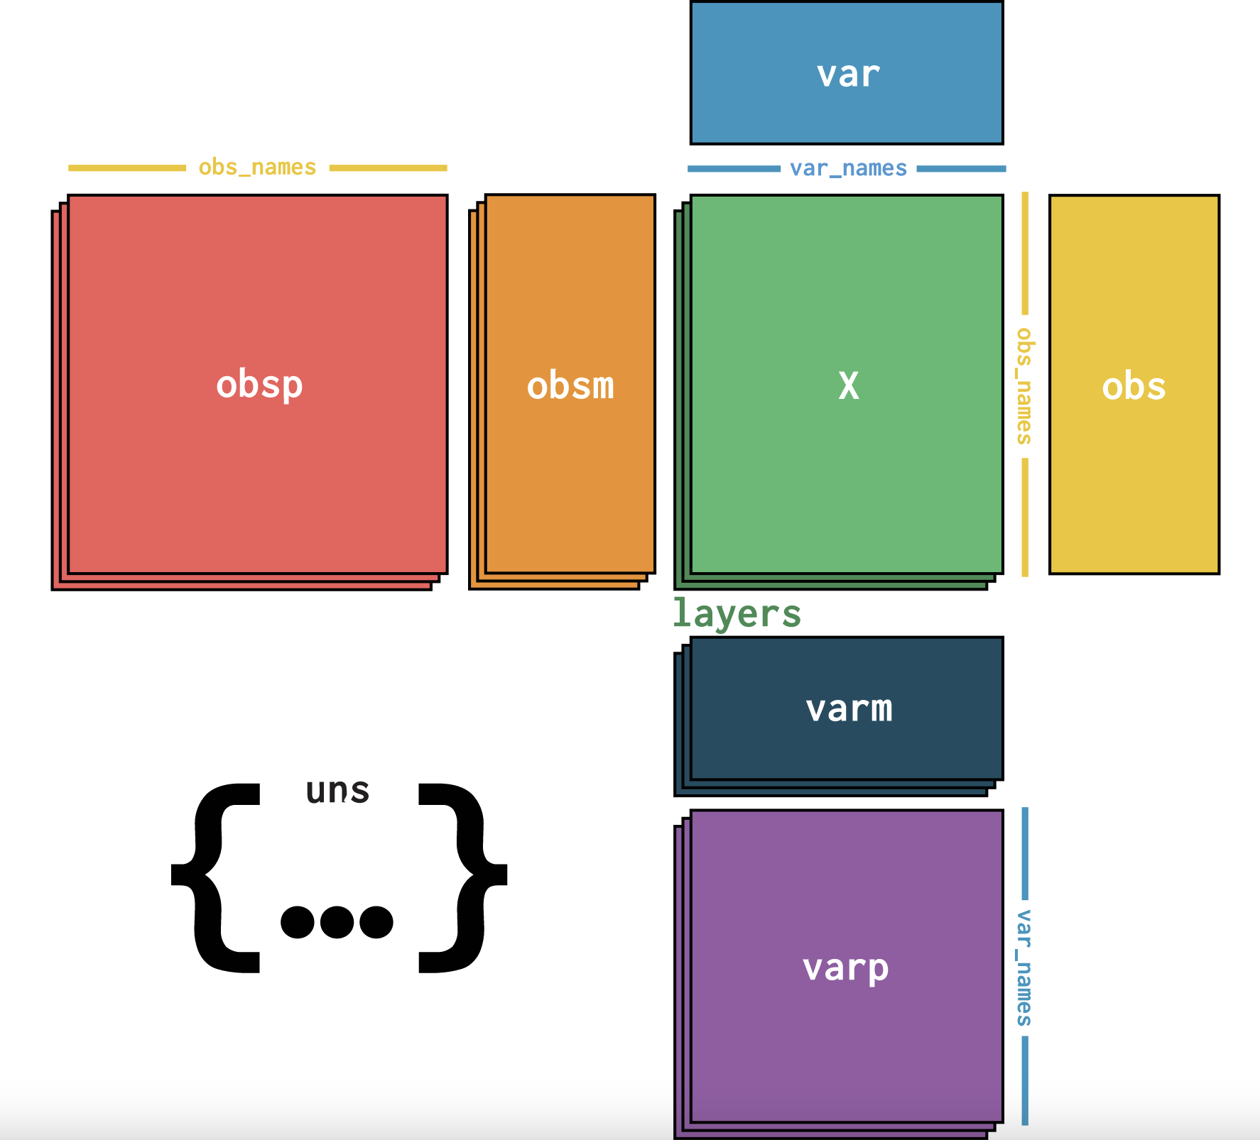
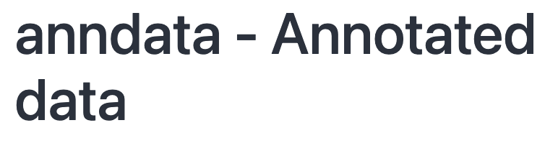

Slide 20
Each gene gets a column
Each cell gets a row

Slide 21
Each gene gets a column
A place to put the gene metadata
Each cell gets a row
A place to put the pairwise cell information (distance, etc.,).
A place to put the cell metadata
A place to put analysis details / settings

Slide 22
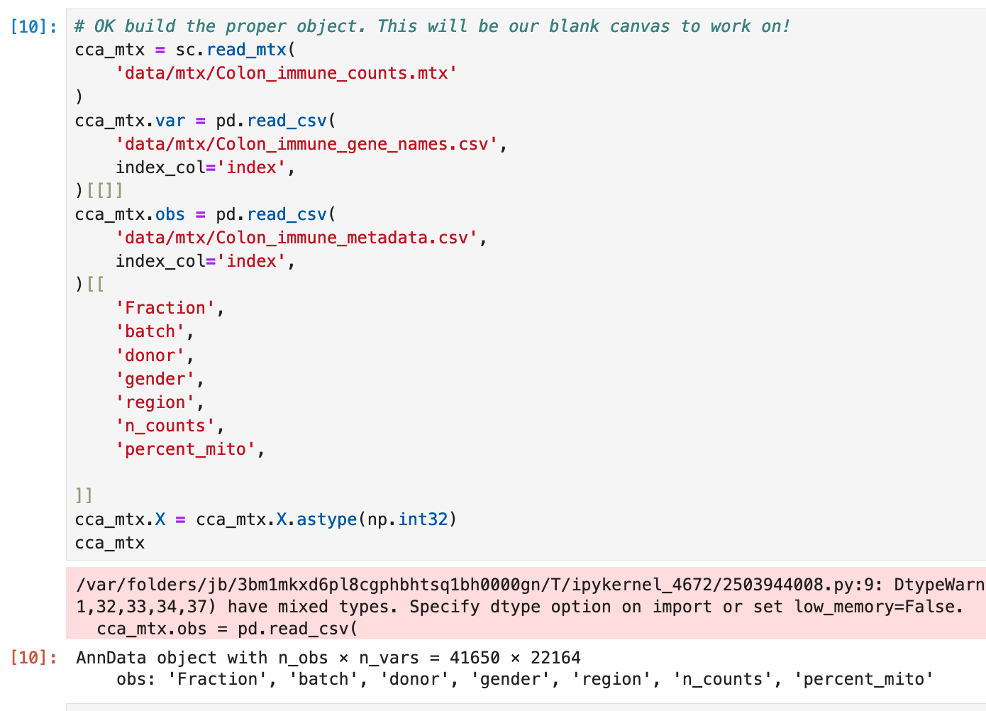
Code to convert the many files describing this experiment into one anndata object we can then work with
Here is the anndata object we created, of 41650 cells and 22164 genes.
The per-cell metadata is also there.

Slide 23
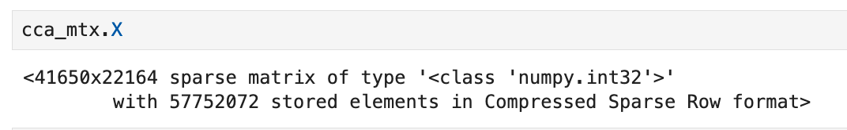
The actual cell-gene-counts are stored as a ‘sparse’ matrix is stored in `.X`
It’s mostly zeros, so we only store the non zero values.
We lose no information doing this.
But the files are much smaller to store and get into memory.
In very large single cell datasets, it may be impossible to load the data at all without using sparse data!
Single cell RNA data, like a lot of ‘omics data, is both sparse and highly dimensional:
The there are lot of observations (cells) over a lot of genes (var) making this highly dimensional.
(e.g., on this dataset there are, in theory, 41,650 x 22,160 possible values to keep track of, or 922,964,000 values).
Most cell-gene combinations have no counts (sparse).
Sparse and dimensional data is easier to handle with special tools.

Slide 24
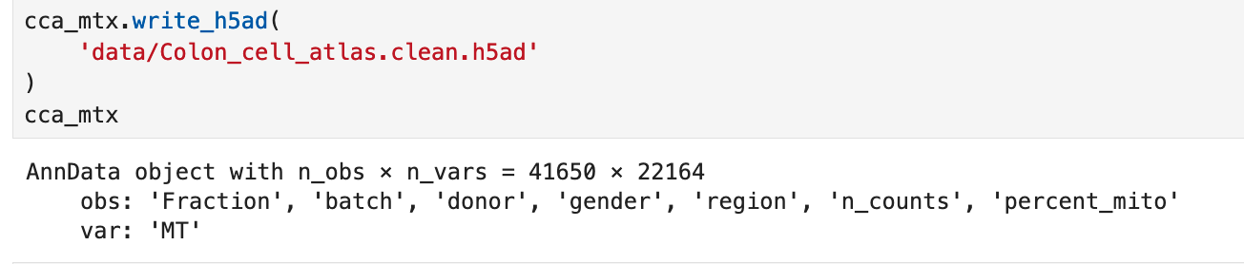
We can write anndata in a format called `h5ad`.
h5ad is very fast to load even large data, keeps track of all the data, metadata, and analysis details for us all in one file.

Slide 25
Step 1: Quality control and identification of cell types

Slide 26
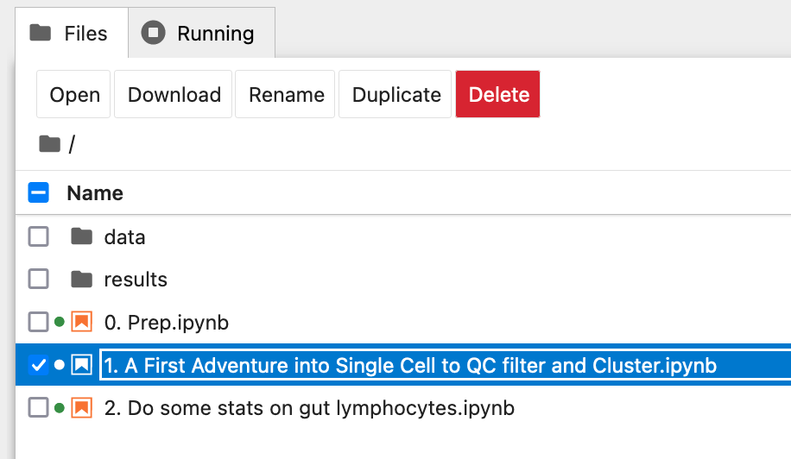
Now this notebook, for those following along
This uses the h5ad we created on the first notebook

Slide 27
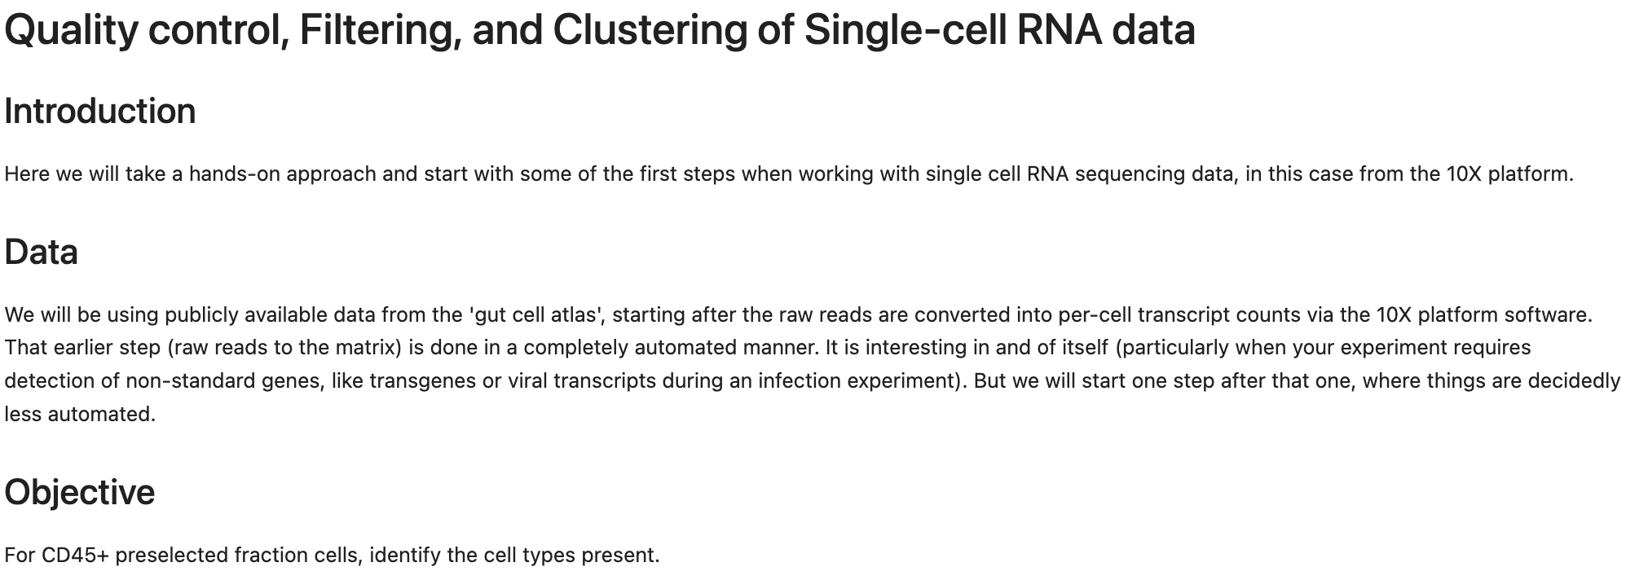

Slide 28

https://xkcd.com/353/

Slide 29
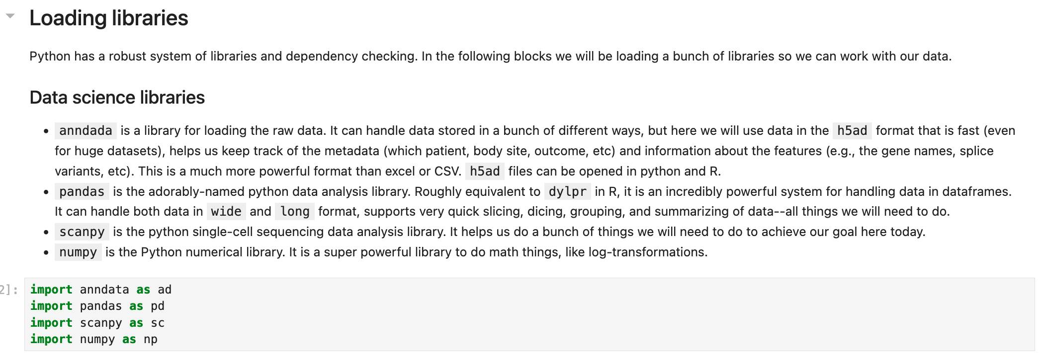

Slide 30
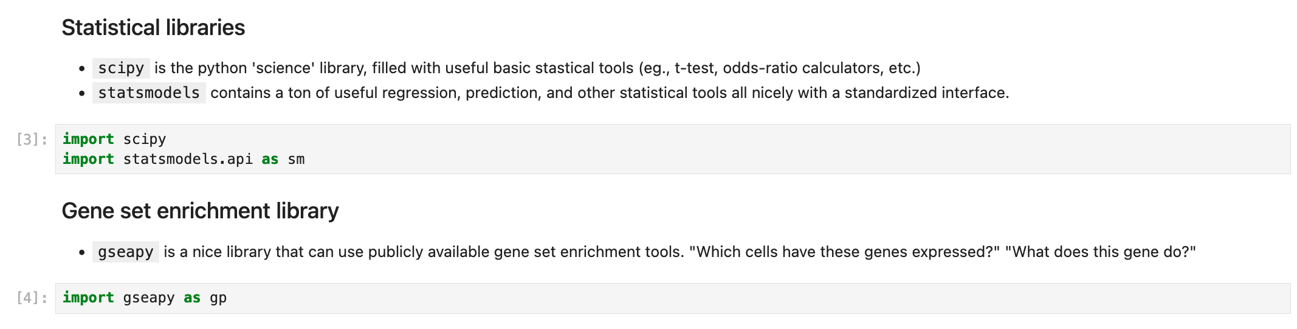
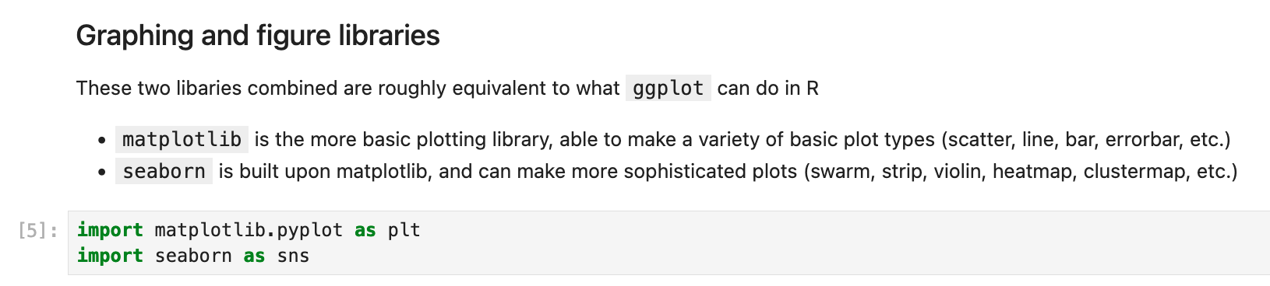

Slide 31
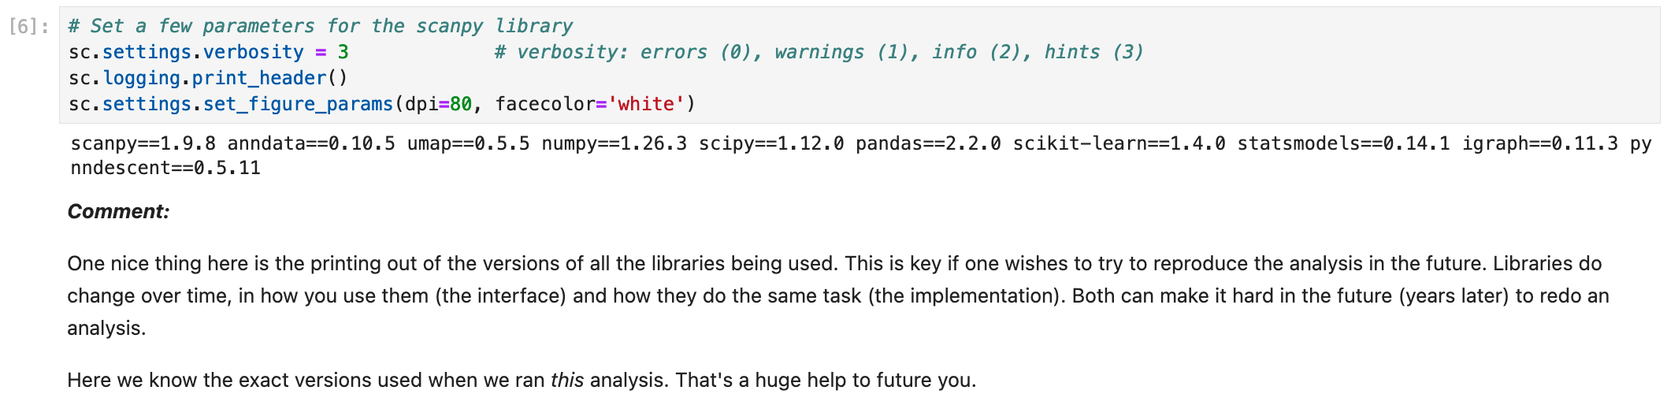

Slide 32
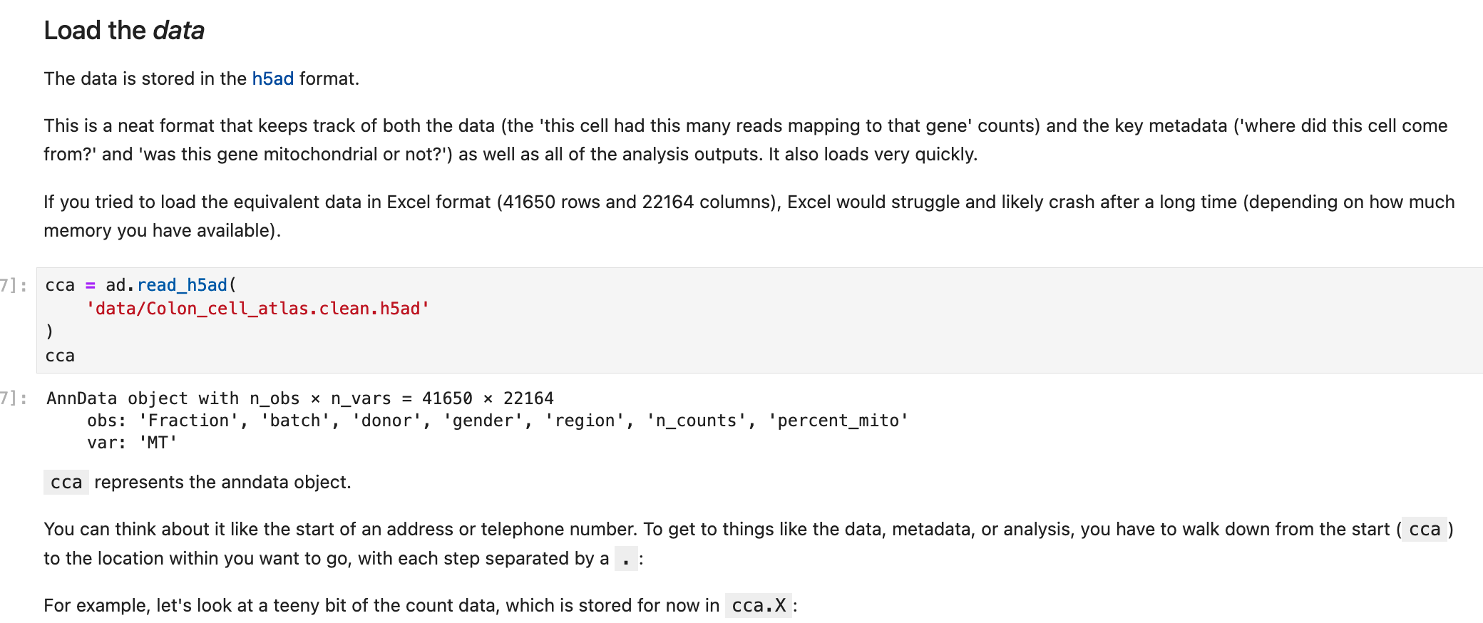

Slide 33
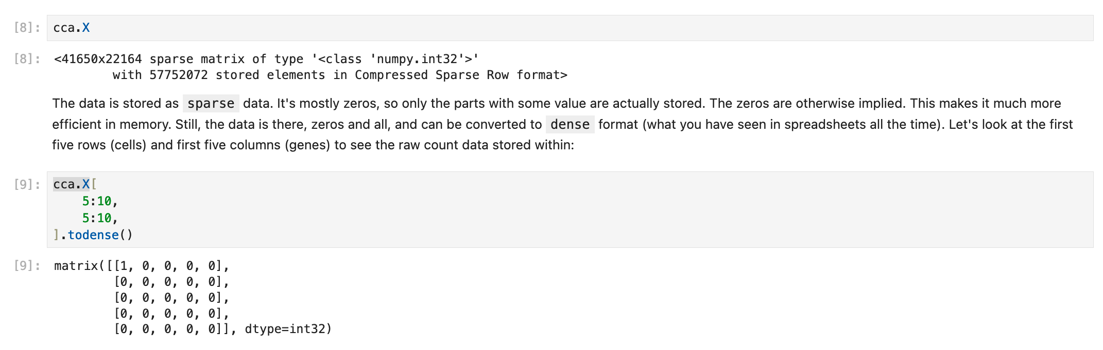

Slide 34
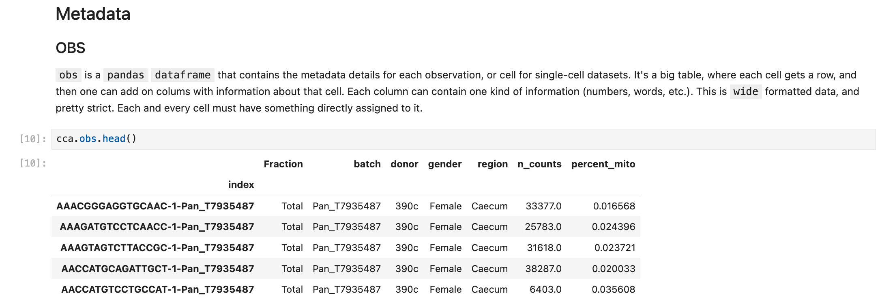

Slide 35
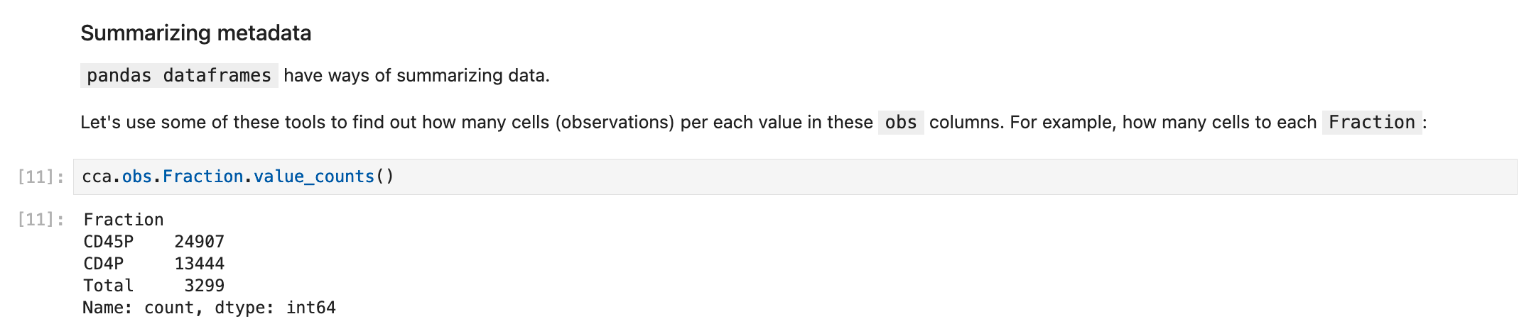

Slide 36
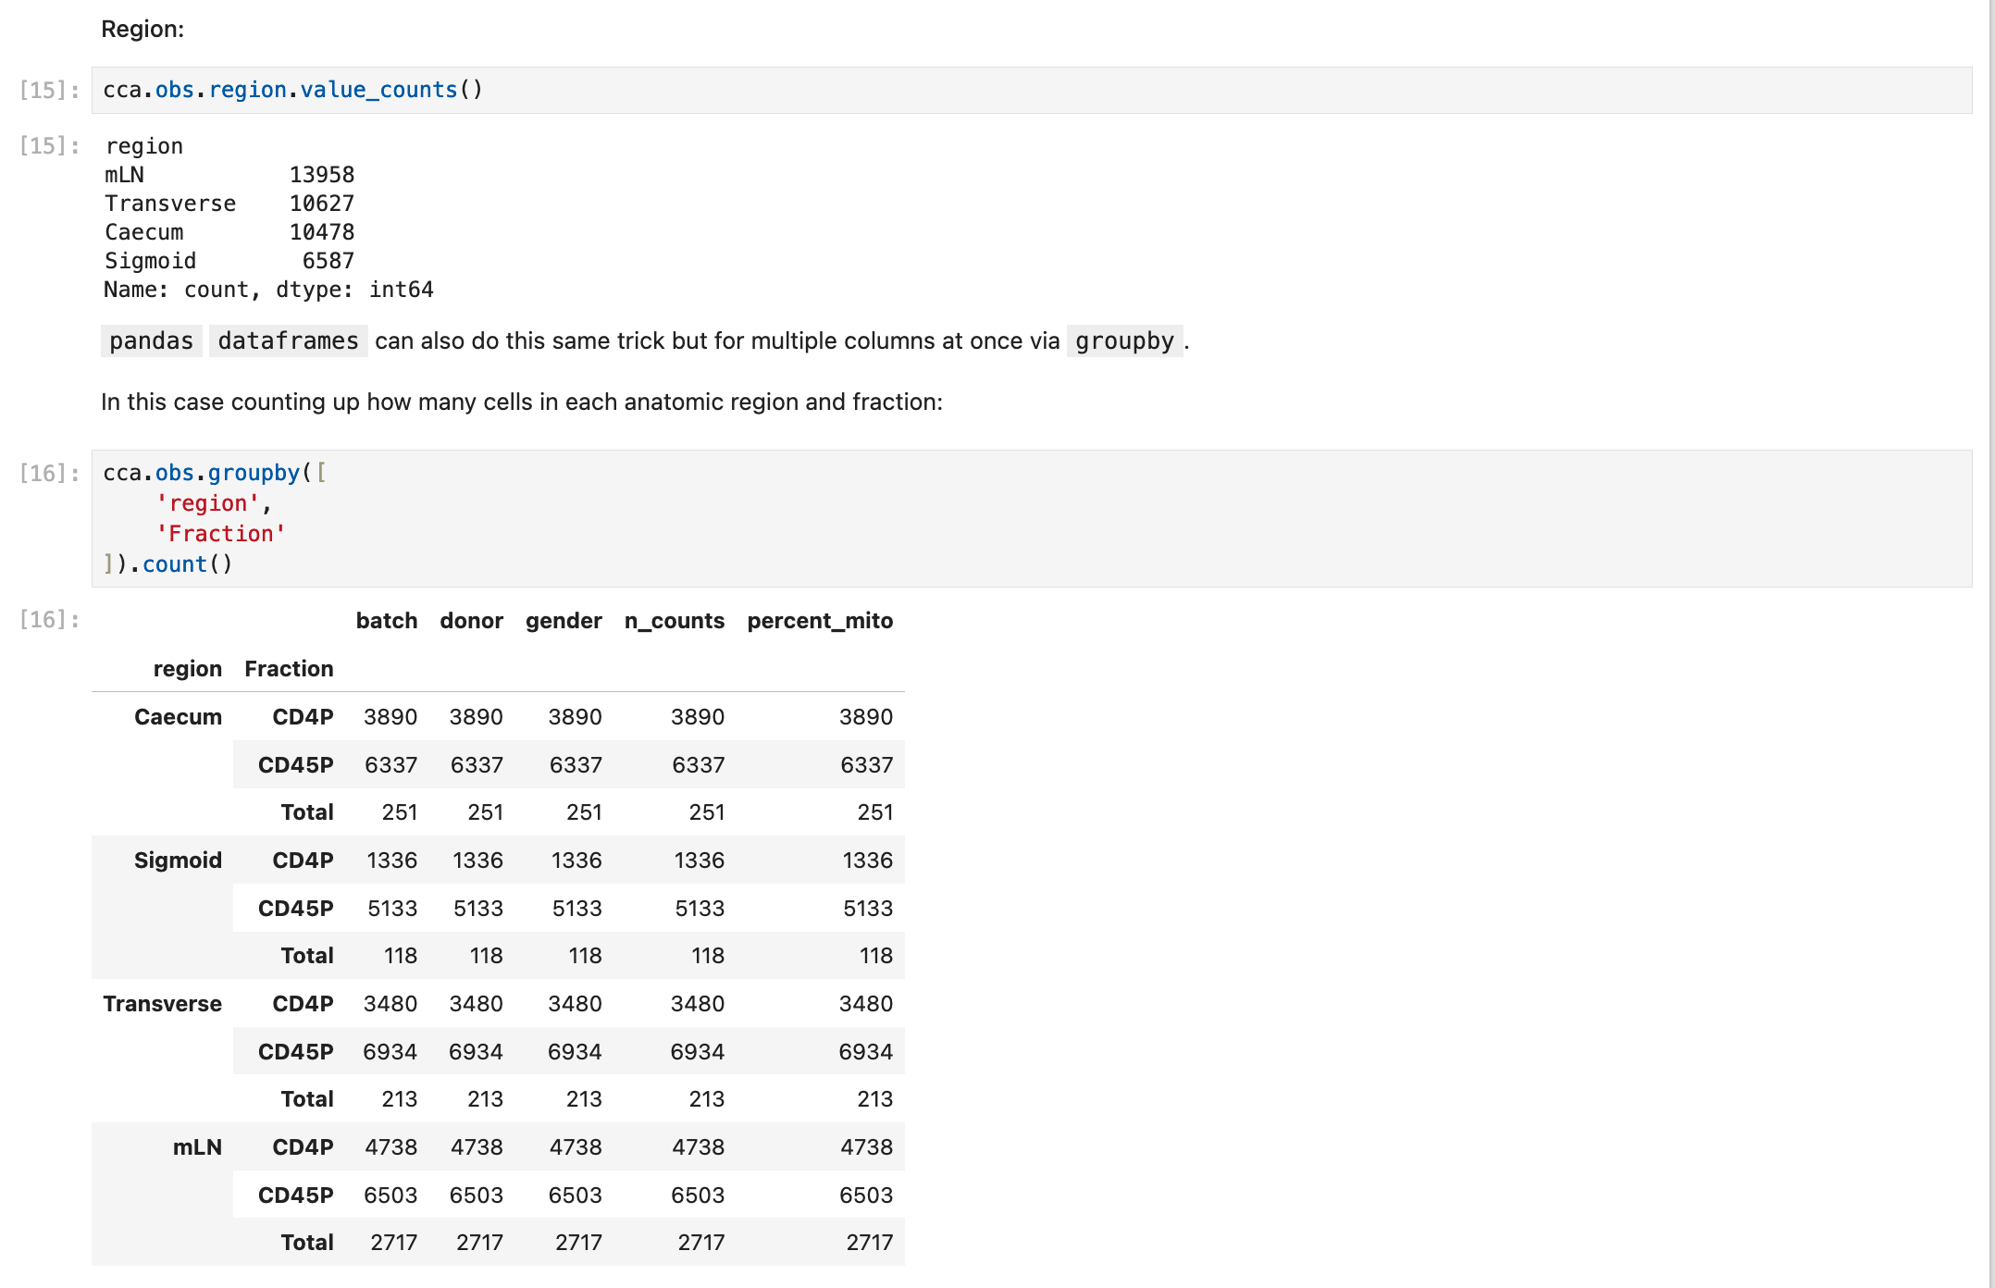

Slide 37
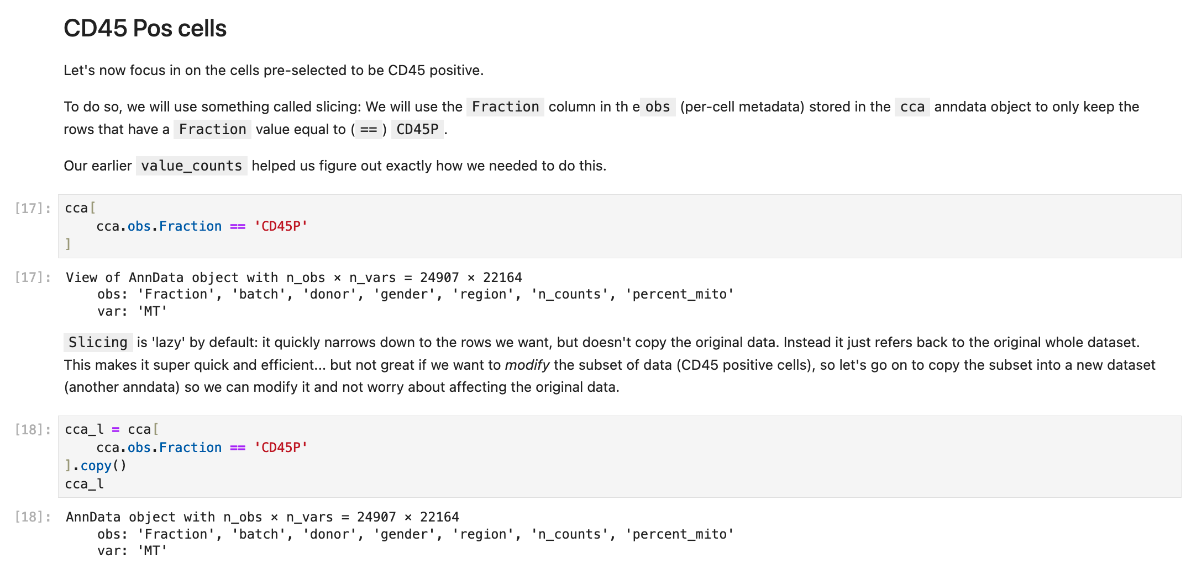

Slide 38
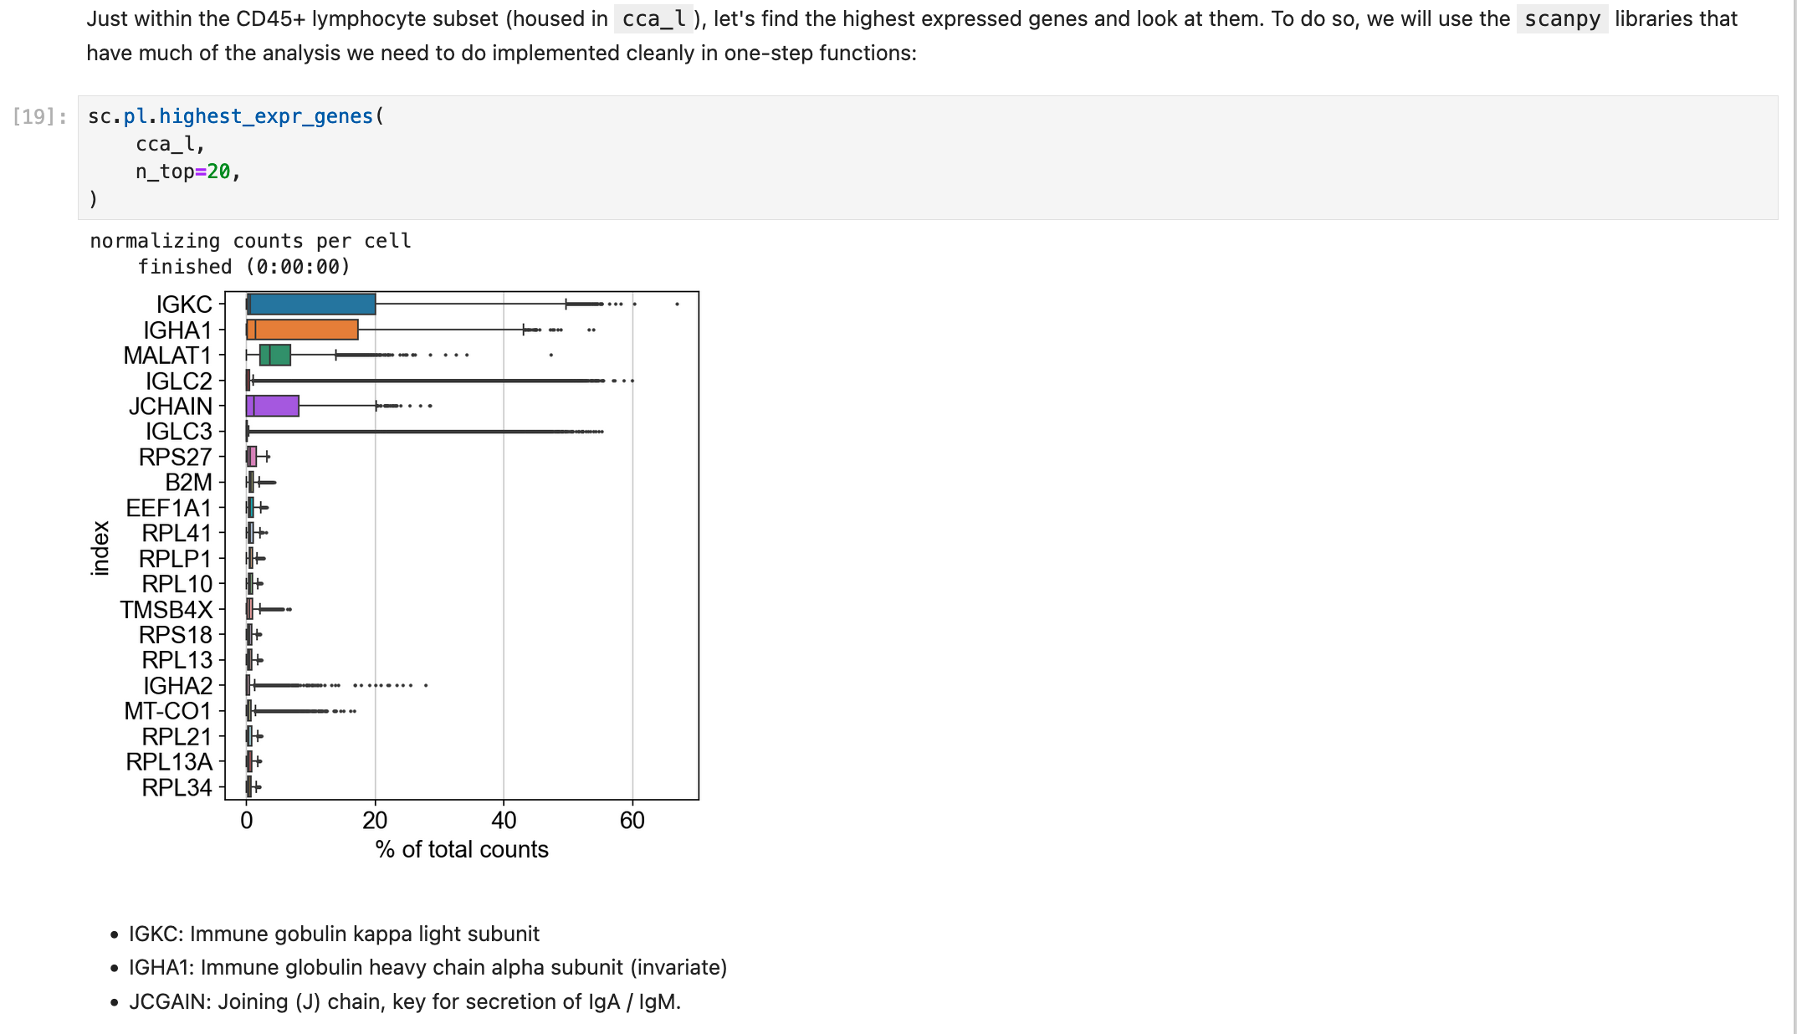

Slide 39
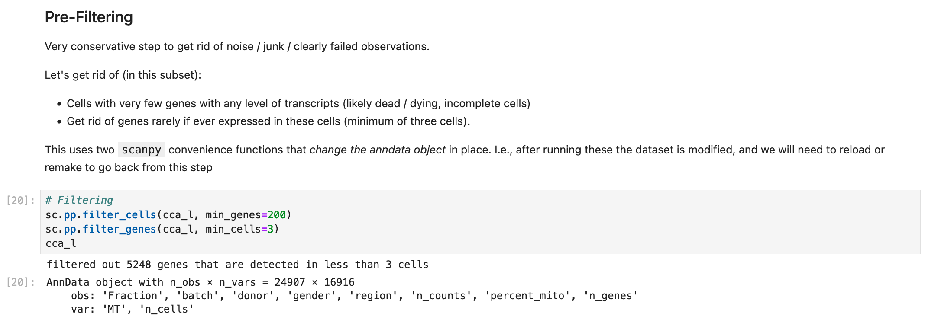

Slide 40
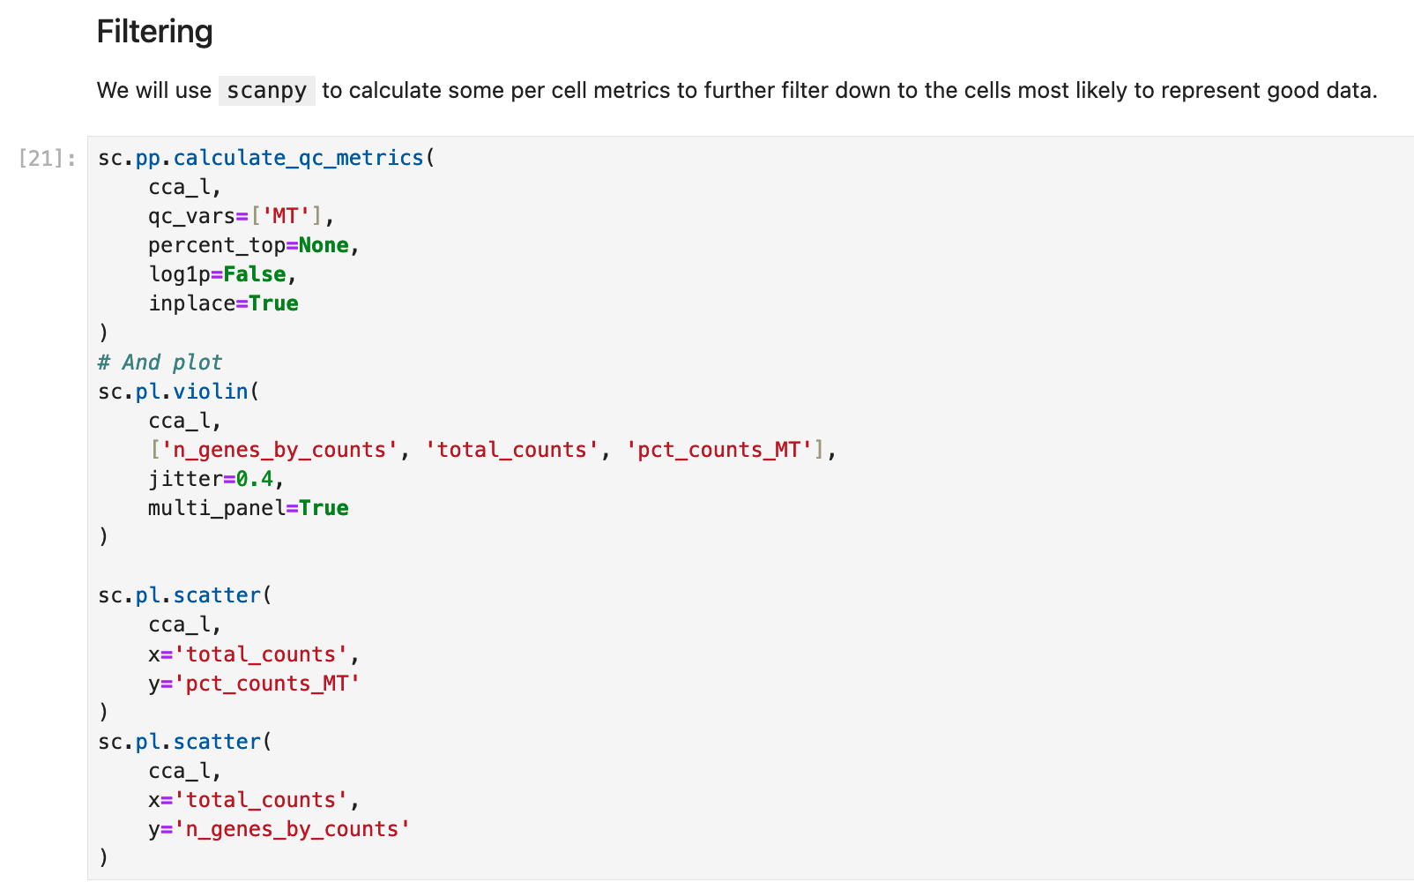

Slide 41
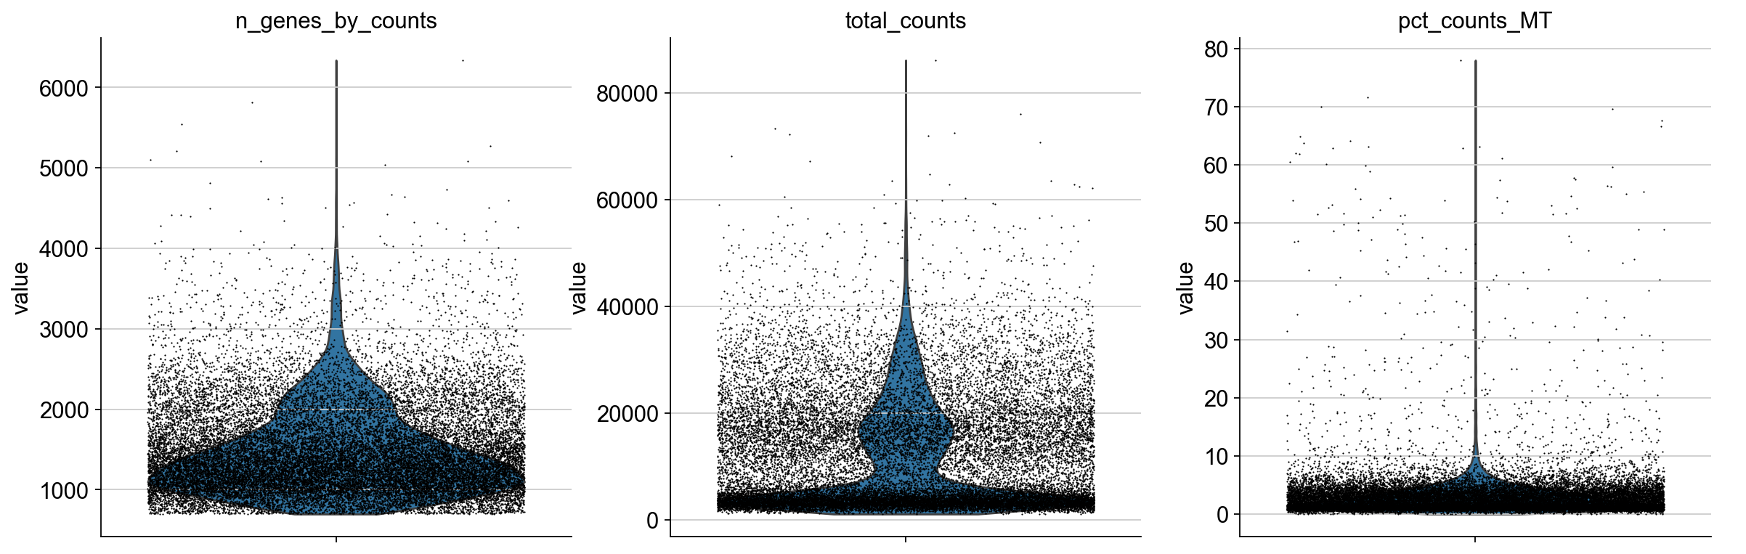
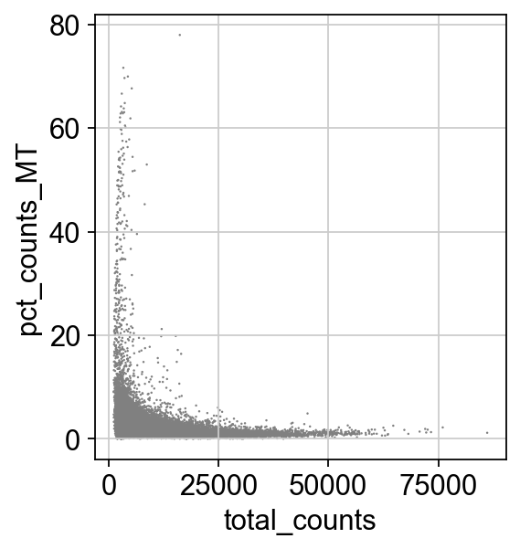
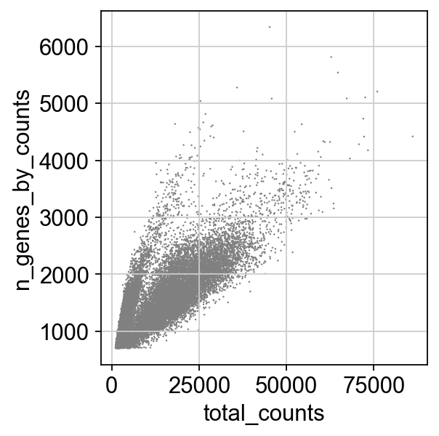

Slide 42
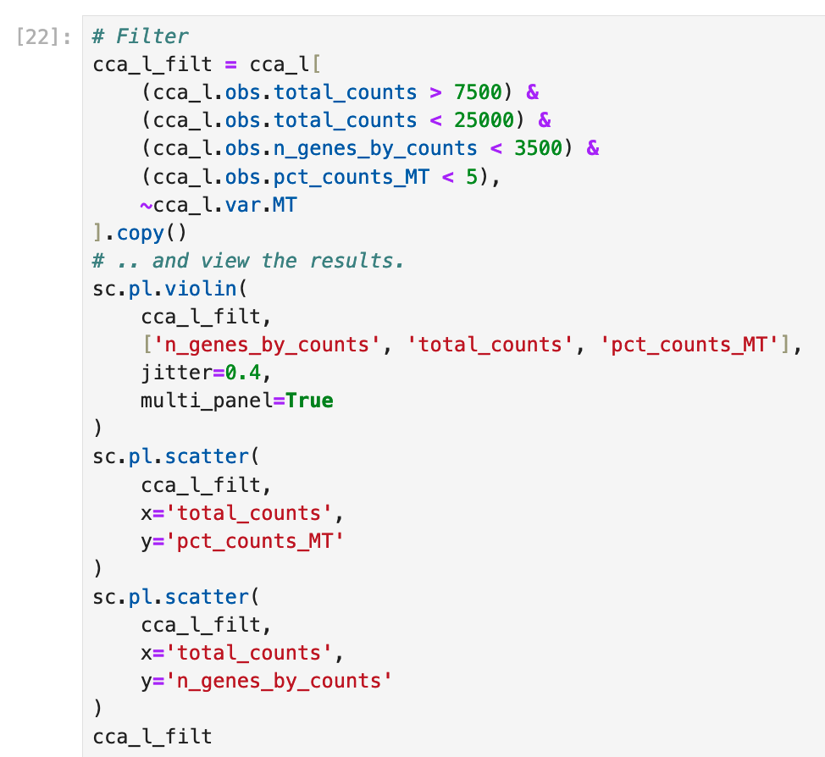
How did I come up with these numbers?
(< 7500; > 25000; etc.)?
It was a subjective process based on how these qc figures are ‘supposed’ to look in a standard analysis.
Do you agree?
What sort of scientific bias can be introduced by the selection of these parameters?
Do you agree with my choices?
How does picking different values (or skipping this filter entirely) affect the conclusions?
Slicing by cell
Slicing by gene

Slide 43
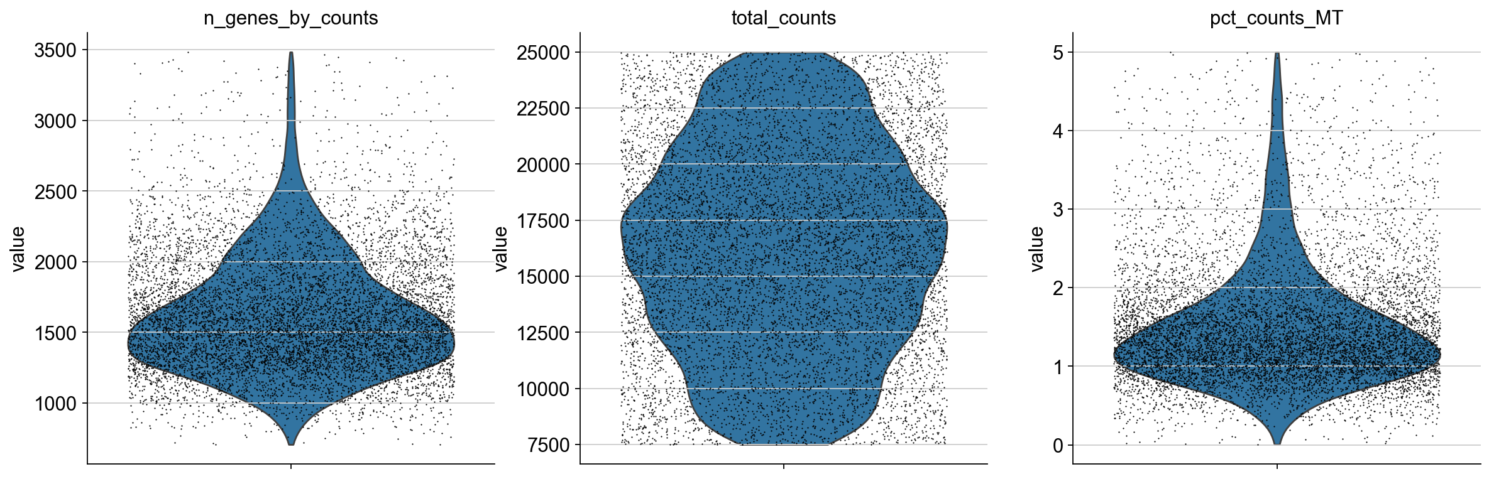
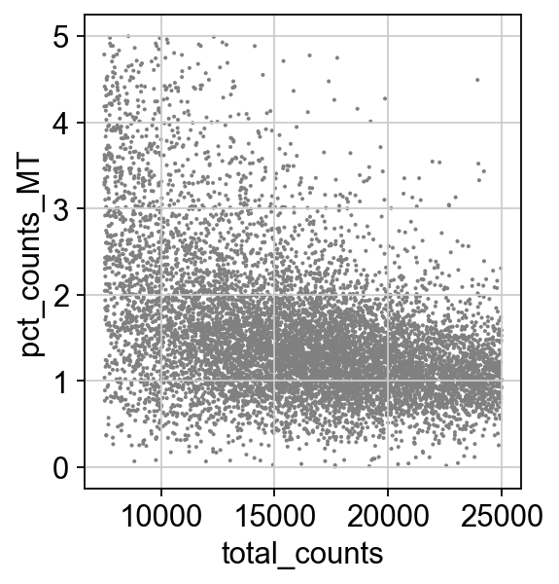
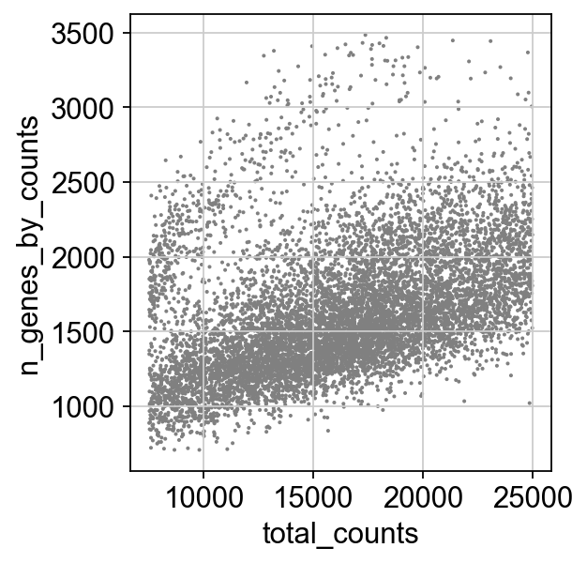

Slide 44
Our filtered anndata object now has fewer cells and fewer genes.
The obs metadata (per cell) now has a whole bunch of per-cell QC data added!
The var metadata likewise has a whole bunch of per-gene QC data added.

Slide 45
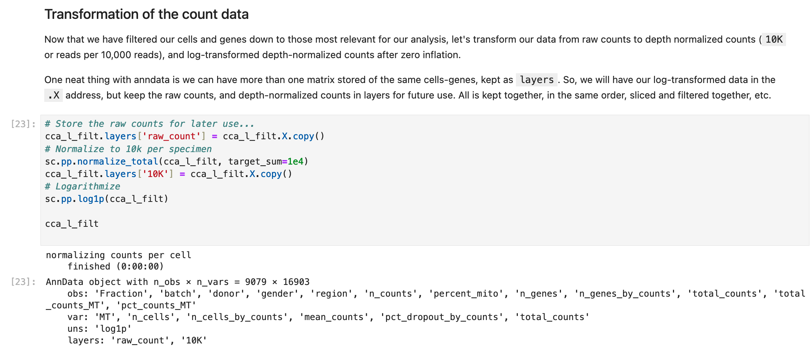

Slide 46
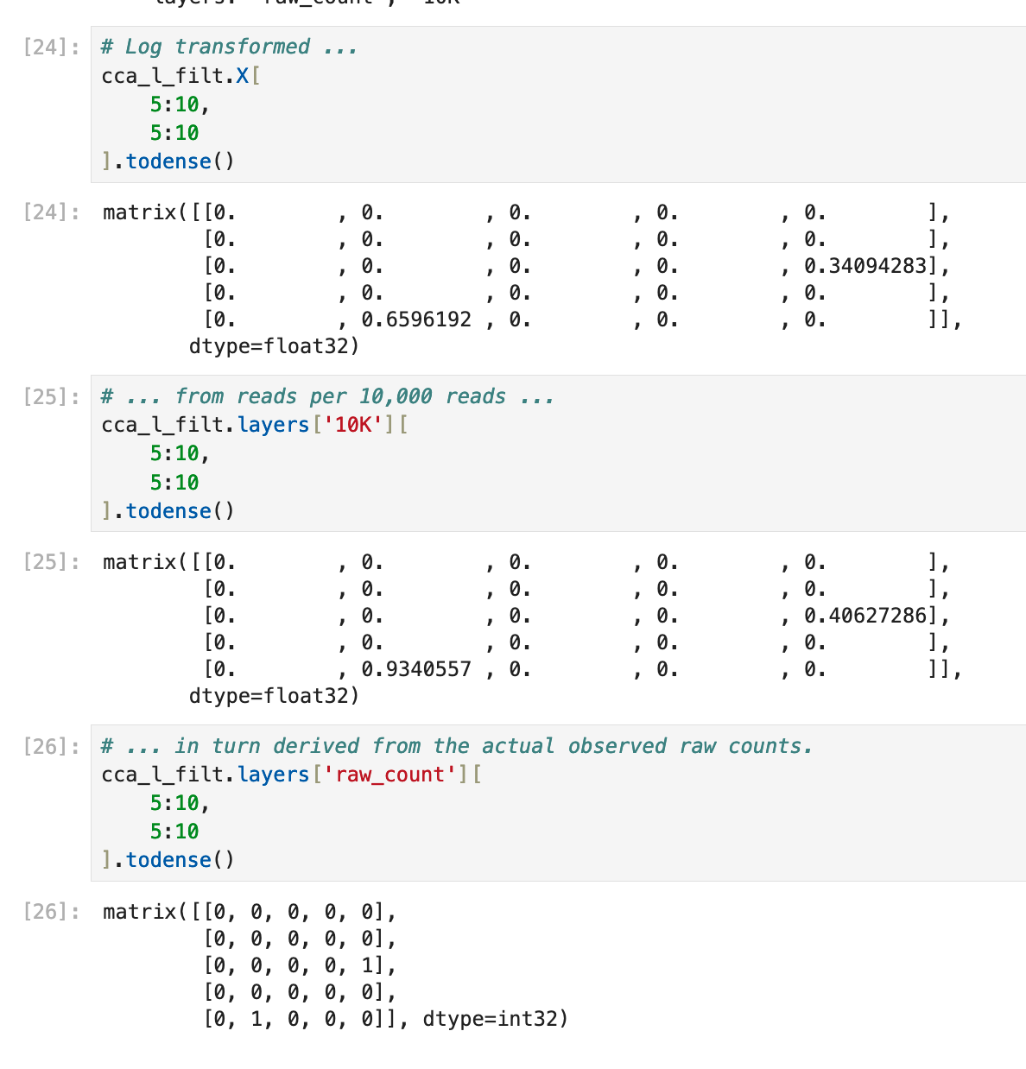
The anndata object now has multiple ‘layers’ of data all stored together and kept tidy and organized for you.
This is like having multiple sheets in an excel workbook, but with the rows and columns automatically kept in order and consistent.
It remains quite easy to keep in memory and speedy to work with even on a modest computer.

Slide 47
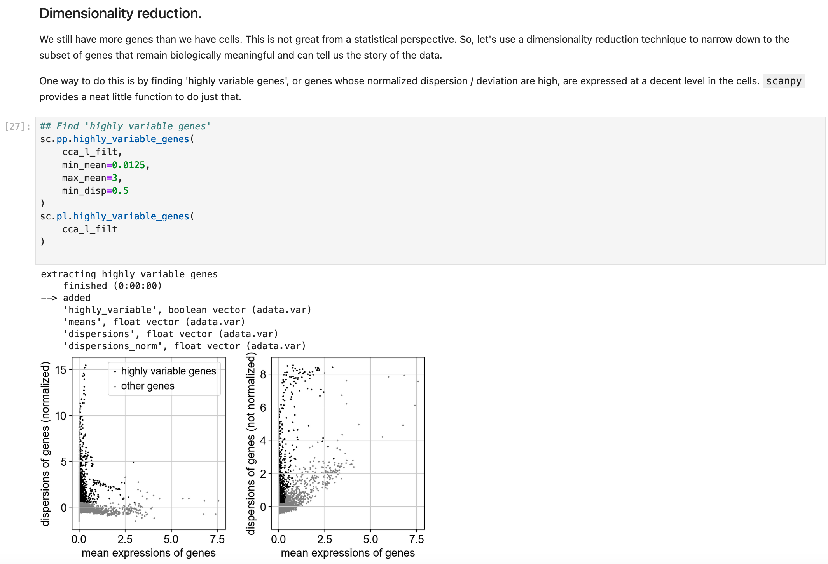

Slide 48
More subjective parameters selected by eyeballing graphs and picking round easy to select numbers.
Do you agree? How does the analysis change with different choices?
What do you think of using this ‘highly variable’ screen to prune down the number of genes we will consider?
What do you think is good and bad about this tactic when trying to identify the cell type of each cell?
How about for finding differentially expressed genes later on for hypothesis testing?

Slide 49
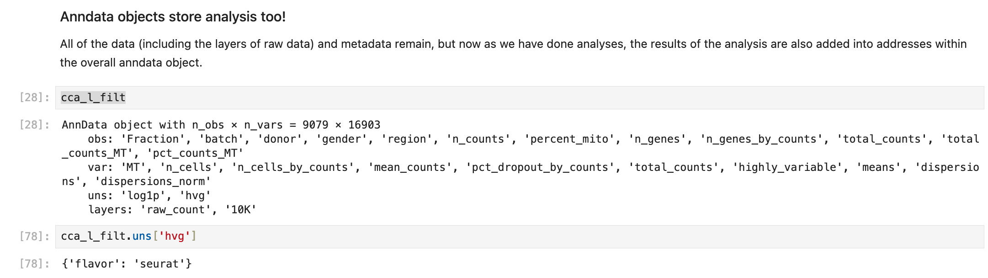
It is a notoriously difficult thing to figure how how an analysis was done later on.
Scanpy tries to help you by keeping track of the analysis choices in the `uns` slot in the anndata object

Slide 50
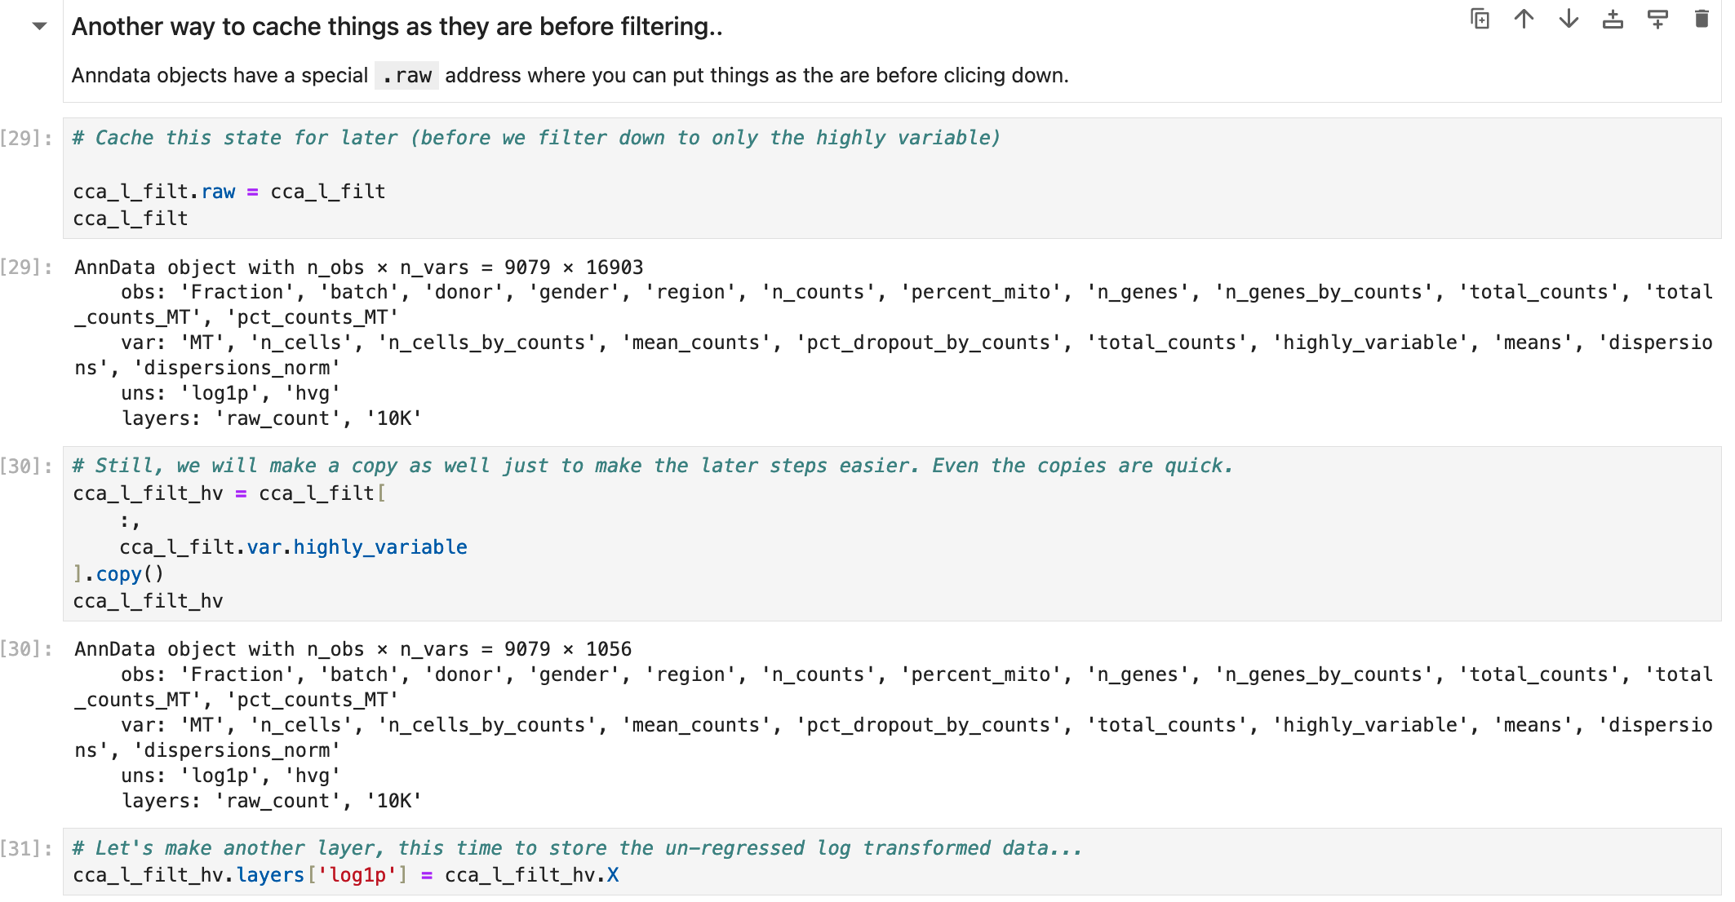

Slide 51
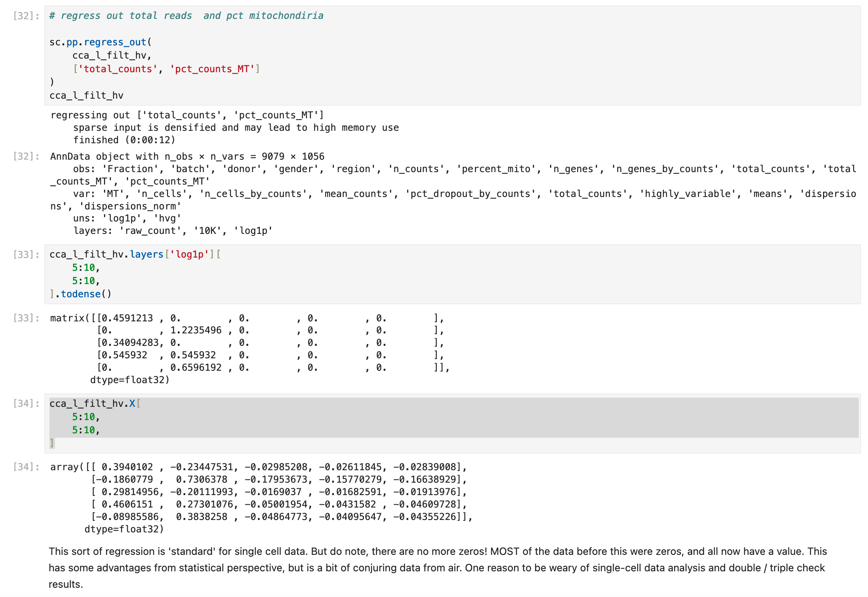
What do you think of the effect of regressing out things like total counts and percent mitochondrial genes?
How do you think the results are changed?
What can you think is better or worse via this approach?

Slide 52
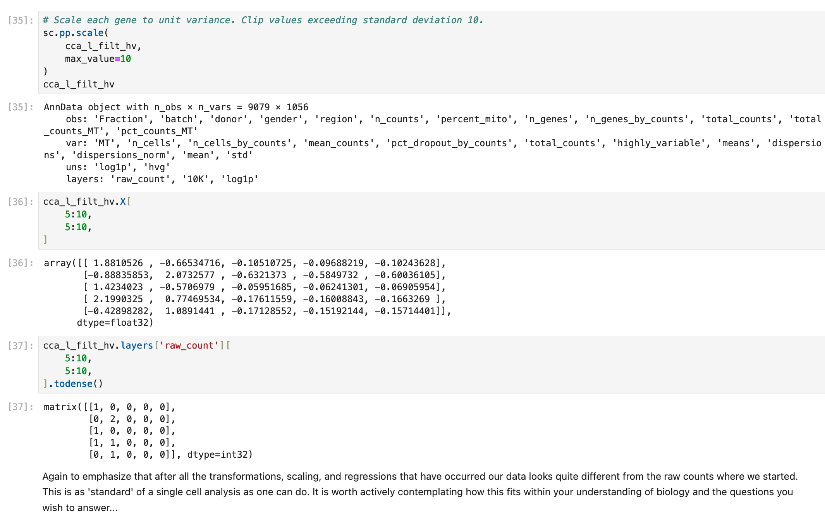

Slide 53
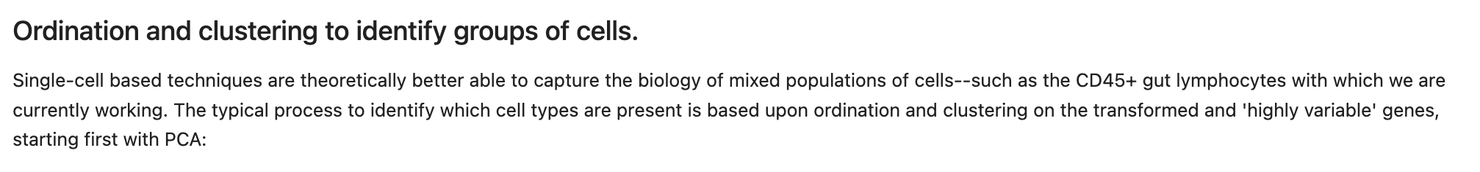
After filtering, scaling, and transforming the data, we now go on to cluster cells together with similar gene expression and identify the cell type of each cluster.

Slide 54
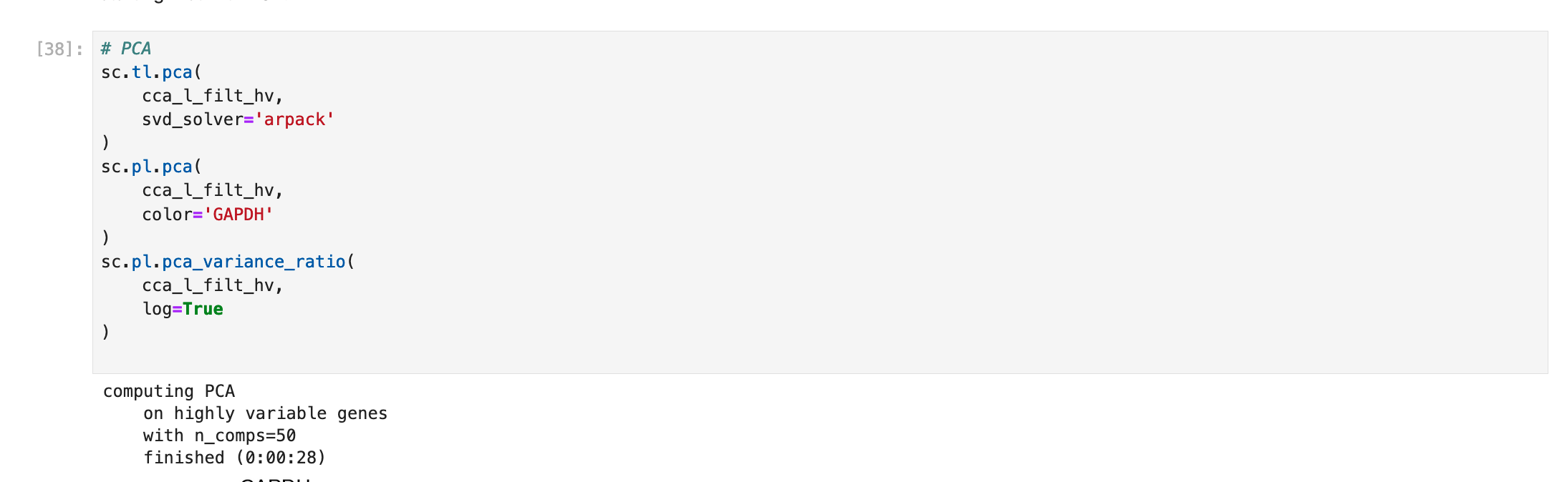
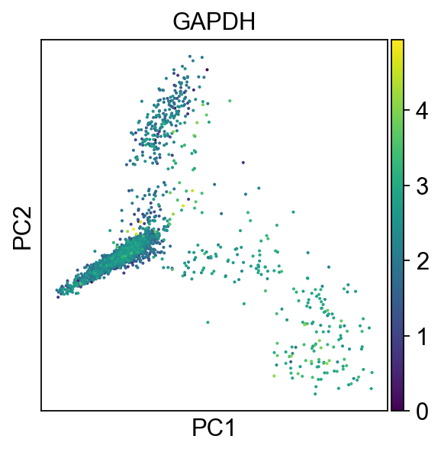
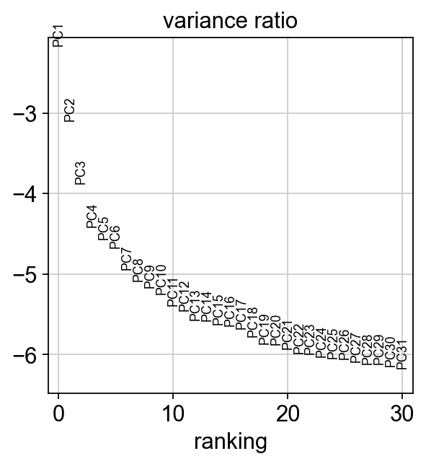
Colored here by the expression of an “housekeeping” gene: GAPDH.
What do you think?

Slide 55
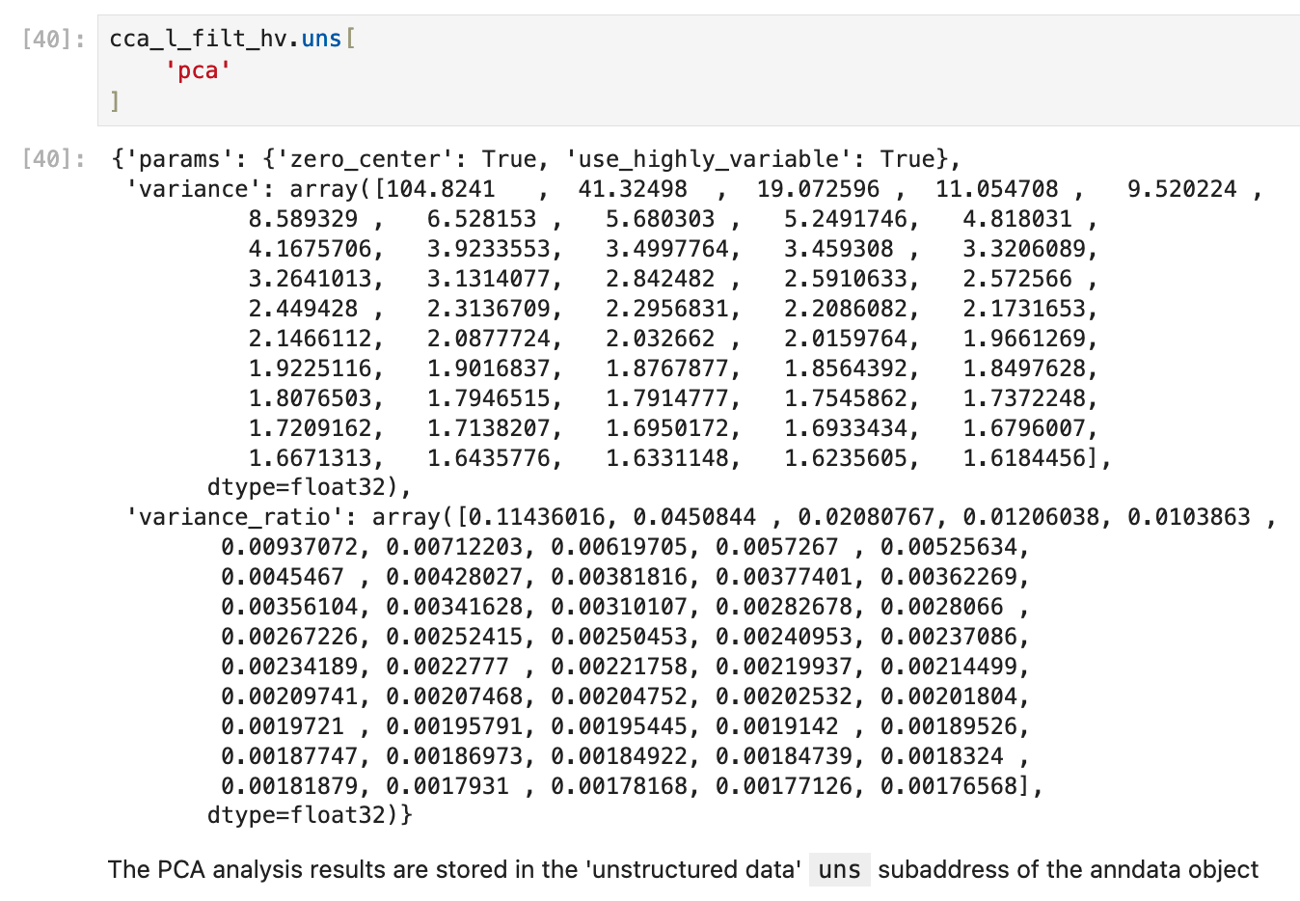
The anndata object keeps track of our analysis choices and results, again in the `.uns` location within the overall anndata object.

Slide 56
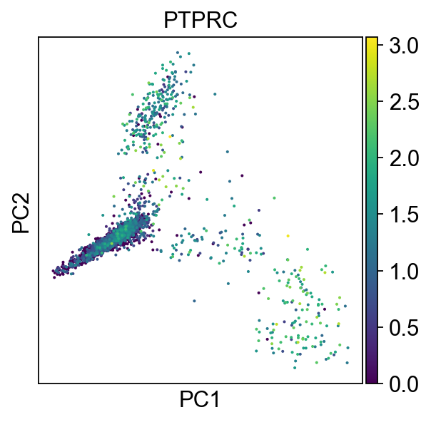
Colored by PTPRC expression (n.e.e., CD45).
This fraction of cells was selected to be enriched for CD45+. So why so variable?
Single cell data has a relatively poor / ‘high’ limit of detection, with only typically 10,000 or so reads per cell. Even very important or distinctive genes may have zero reads assigned to a cell even if they are actually expressed and even detectable by protein-based techniques (FACS, MACS, etc.)

Slide 57

The `.obsp` location within the anndata object keeps track of pairwise values (like distances). The `uns` continues to store the analysis settings.

Slide 58



Slide 59

UMAP ordination plots. Each dot represents one cell. The intent is to have the cells with more similar gene expression overall placed more closely together on this 2D representation. The distances are based on the neighbors analysis we did earlier.
How do you think the shape and direction of these graphs would be changed by all the choices we have made along the way (filtering, gene selection, neighbor identification, pairwise distance calculation, etc.)?

Slide 60



Slide 61
The ‘resolution’ parameter can dramatically change how many clusters are identified!

Slide 62





Resolution 0.5
Resolution 0.4
Resolution 0.3
Resolution 0.2
Resolution 0.1
Here we explore over a reasonable range of values the outcome as we change the ‘resolution’ parameter. This is a form of both parameter tuning and sensitivity testing.
The only way to do parameter tuning and sensitivity testing wrong is to not do it.

Slide 63
I ultimately selected a resolution parameter of 0.1.
Do you agree?

Slide 64


Slide 65
The concept here is each ‘cluster’ represents cells of the same type.
For CD45+ cells like these, it is a question of which lymphocyte is represented? B-cell? T-cell? DC? Etc.,
So, how do we go about identifying the cell types?

Slide 66

The concept here is each ‘cluster’ represents cells of the same type.
For CD45+ cells like these, it is a question of which lymphocyte is represented? B-cell? T-cell? DC? Etc.,
So, how do we go about identifying the cell types?

Slide 67


Slide 68

Beyond the identification of clusters being quite subjective (and quite sensitive to the parameters and methods selected), how the per-cluster DEGs are found is also quite subjective.
How the DEG are used to name clusters is really an art form, and often done by eyeballing and the analyst’s experience with the gene expression in the relevant tissue.
Here we will use a gene-set enrichment approach backed by the Azimuth Cell type database data.

Slide 69

Based on the DEGs fed in, we get the cell types most known for those genes. The score is based on coverage of that cell type’s genes.
e.g. for cluster 4 for 18/20 of the genes that are identifying (according to Azimuth) for CD16+ monocytes are also DEG for Cluter 4.

Slide 70


This is quite artful / subjective.
Do you agree with my assignments? The Azimuth cell type identifiers?
How could these be made inaccurate by external factors (like infection, drug treatment, etc.)?

Slide 71

The cell type IDs from my independent analysis
How well did my independent and ‘blinded’ analysis match up to the ’official’ results?
Do you feel more or less reassured by the veracity of these cell type IDs after this comparison?
What ways do you think this could be more scientific and less artful?
The ‘official’ peer reviewed and published cell-type IDs for this dataset.

Slide 72
2. Statistics and regression of single cell data
Introduction
Here we will take a hands-on approach and build upon our cell type identification efforts in step one to try out a few basic statistical analysis of the single cell data, here the preselected CD45+ fraction of cells.
Data
We will be using processed data from step one, of CD45+ fraction of cells from four distinct regions of the gut.
Objectives¶
Is the distribution of cell types consistent across regions?
Within monocytes, are there region-specific gene expression patterns?

Slide 73


Slide 74


Slide 75



Slide 76


Slide 77


Slide 78



Slide 79


Slide 80
Association considerations:
Like most single-cell data, it's very low count and mostly zeros. Further, given a relatively high limit of detection, a lot of those zeros are not actually zero--but instead 'transcription below the limit of detection’.
These can cause issues if you treat the expression here as a comparison of means (e.g., GLM, logistic regression, etc.), as you are most likely going to be comparing a mean mostly made up of zeros to a mean also made up of zeros.
Another consideration is that while there are many cells, they ultimately represent repeated sampling of a handful of biological replicates (donors) and spread over multiple batches in processing.
The appropriate statistical test to use here is non-trivial. I often start with something very basic and simple. For this question, I would start with a detected-or-not contingency table and chisquare, and then move on to fancier techniques, but this is far from standard.

Slide 81


Slide 82



Slide 83


Slide 84


Slide 85


Slide 86



Slide 87



Slide 88
Conclusions (1/2)
- Single cell RNA data (like most ‘omics data) is highly dimensional: With many observations (cells) and many variables (genes).
- Single cell RNA data (like most ‘omics data) is sparse: Most var (genes) are not detected in most observations (cells).
- Sparse and highly dimensional data may require specialized tools to store and open the data. Trying to load up the raw data (mostly zeros, with many rows and columns) in a more typical tool like Excel will result in the need for a lot of computer memory (likely more than exists on a typical computer), and very poor performance even if it does load.
- It is important to make sure the data (e.g., cell-gene-counts) and metadata (information about the cells) are kept organized and consistent with one another. Being able to split / slice the data and metadata together. Tools like anndata structures make this much easier, and further allow for details like analysis results and parameters to be also kept with the data and metadata in a tidy and portable manner.

Slide 89
Conclusions (2/2)
- There are multiple subjective steps in the quality control and processing of single cell RNA data. These include things like filtering out ‘low quality’ cells based on total reads, genes-per-reads, percent mitochondrial reads, etc. For genes, these include selection of ‘highly variable genes’. For oridination these include the clustering algorithm, distance and neighbor identification metric. For clustering, these include clustering thresholds.
- Parameter tuning is when you try out a reasonable range of values for the parameters used in filtering, ordination, and clustering and have some definable means by which you are picking a value.
- Sensitivity testing is when you determine how much a change in a parameter effects the ultimate conclusion or output. Sensitive parameters are really tricky, and it is generally better to use approaches with parameters that are less sensitive (i.e., the result does not change very much with the parameter).
- The only way to do parameter tuning and/or sensitivity testing wrong is to not bother doing it. Try to avoid using ‘default’ values for parameters without first trying a reasonable range and seeing how the output is effected and how sensitive your conclusions are to which parameter is selected.

